Slide 1
AEMO Consumer Forum
November 2020
Guideline

Slide 2
We acknowledge the Traditional Owners of country throughout Australia and recognise their continuing connection to land, waters and culture.
We pay our respects to their Elders past, present and emerging.

Slide 3
Today’s meeting
 | Item | Duration | Time
1. | Welcome and introductions | 15 minutes | 9:30-9:45am
2. | 2020-2021 Summer Readiness overview (John Deere) | 25 minutes | 9:45-10:15am
3. | Jemena household energy demand trial (Jesse Mills & Stephen McLennan) | 10 minutes | 10:15-10:25am
4. | NEM power system design and engineering framework (Chris Davies) | 20 minutes | 10:25-10:45am
 | Short break for drink and stretch | 5 minutes
5. | Quarterly Energy Dynamics update (Paul Austin) | 40 minutes | 10:50-11:30am
6. | Distributed Energy Program update (Scott Chapman) | 30 minutes | 11:30-12pm
7. | Forum review project update (Antara Mascarenhas) | 15 minutes | 12:00-12:15pm
8. | Other business & close | 15 minutes | 12:15-12:30pm
Please note that this session will be recorded for the purpose of minute-taking.

Slide 4
Jemena household energy demand trial

Slide 5
Non-incentivised Demand Response Trial
AEMO Consumer Forum
November 2020

Slide 6
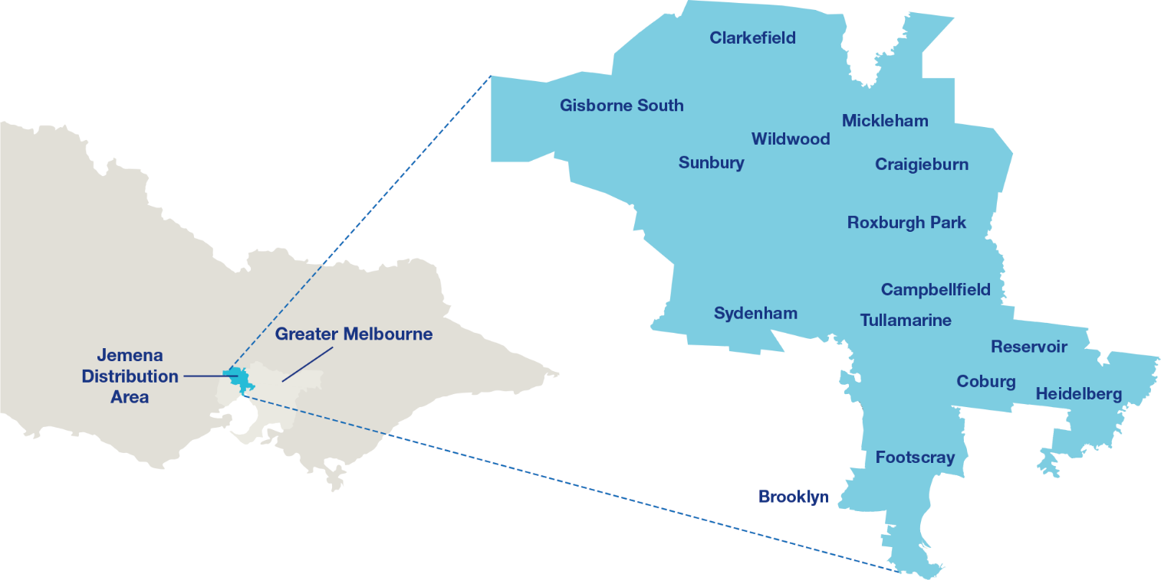
Jemena and AEMO are collaborating to test non-incentivised demand response this summer
Why?
Empower customers through information
Test if customers will reduce power consumption if encouraged to do so for the benefit of their community
On 5x 35° + days between 1 December 2020 and 28 February 2021
When and where
Who?
5,000 JEN residential customers will be opt’d in to communications (customers to be given chance to opt-out)
Customers selected based on consumption behaviour (JAWS)
SME & Large Businesses’ excluded as less responsive to temperature and already have RERT

Slide 7
Our previous research & experience tells us that our customers want to know how they can help reduce the change of power outages. The approach taken will be community oriented.
How?
Jemena will send 3 SMS.
Day before high temp
Day of high temp
Day after event
DRAFT
1
2
3
Hi, this is Jemena, your local electricity distributor. Very hot weather is forecast for tomorrow. High temperatures increases the demand for electricity, which can increase the chance of power outages. You can help your community reduce the chance of power outages by reducing the use of large appliances. Stay safe. To opt-out jemena.com.au/opt-out
From Jemena: Temperatures are forecast to peak between 4pm and 5pm today. With more people in Melbourne at home, there is a higher chance of power outages. You can help maintain the power supply in your community by reducing use of big appliances like washing machines or setting your AC temp between 23 to 26 degrees.
Thank you for helping your community to reduce the chance of a power outage during yesterday's hot weather. Your actions make a difference. Do you have any feedback for us? Let us know here: {{bitly}}
To opt-out jemena.com.au/opt-out

Slide 8
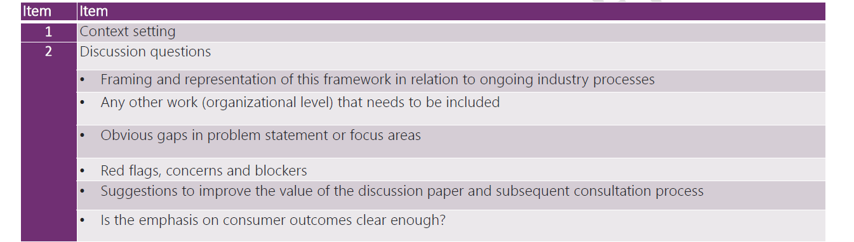
NEM power system design & engineering framework

Slide 9
Break – 5 minutes

Slide 10
Quarterly Energy Dynamics
Q3 2020
Market Insights

Slide 11
Distributed PV and COVID-19 shaped NEM operational demand
NEM operational demand down 1.4%
Rapid decline in minimum demand
Record high distributed PV capacity installed during the last 6 months
COVID-19 largest impact reducing the morning peak
New minimum demand records set in Q3 - SA and VIC broken again in Q4
Notes:
~

Slide 12
Vic lockdown impacts energy shape
Electricity morning peak reduced
Higher demand during day on cold days Days where demand exceeds 1,100 TJ
Morning peak starts later & stays higher during the day
Overnight demand lower
Largest reduction in morning peak
Notes:
~

Slide 13
Lowest Q3 gas prices since 2015
Gas spot prices also fall up to 50%
ACCC netback prices at record lows
Text
Notes:
~

Slide 14
Lowest Q3 electricity prices since 2014
Mainland NEM spot prices decline ~50%
Forward curve stabilises at lower prices (Cal21 swaps)
Notes:
~

Slide 15
Return of coal stations displaces gas
Gas squeezed out despite lower prices Change in supply – Q3 2020 versus Q3 2019 by time of day
Dry July: lowest Q3 hydro output since 2008
Dry Tas conditions the key driver
New capacity driving VRE output increases
Gas being displaced despite lower gas market prices
Notes:
~

Slide 16
Lowest system costs in more than 2 years
System costs continued to decline
Lower directions costs than Q3 2019 despite more time on direction
90th Percentile compensation price has come down

Slide 17
FCAS costs decline; Hornsdale battery adds new supply
Hornsdale battery captures 17% of NEM wide FCAS market share following expansion
Lowest FCAS costs since Q1 2018

Slide 18
DER Program Status update
Scott Chapman, Group Manager - Distributed Markets & Services

Slide 19
AEMO DER Program
AEMO’s DER Program is designed to:
explore emerging markets,
maintain network stability with high levels of DER, and
pioneer best-in-class new products and services
…for all Australian consumers. ​
Consumer investment in DER is driving the need for two-way electricity flows, allowing households to be rewarded for participating in the energy market
Notes:
Brief introduction on the DER Program

Slide 20
DER integration - challenges and opportunities
MINIMUM
DEMAND AND
SYSTEM SECURITY
TECHNICAL
STANDARDS
MARKET
REQUIREMENTS
Active DER management
Load shifting (including utility-scale energy storage)
Frequency control services – both fast and slower acting
Transmission voltage control services
Our qualifications
Information Standards
Quality/Reliability Standards
Compatibility / Interoperability Standards
Regulatory Reform
Two-sided market development
Scheduling and Ahead market mechanisms
Operating envelopes
New products and services (e.g. VPPs)
Consumer understanding

Slide 21
Six core DER workstreams are underway to enable active DER integration
DER Register – database of DER devices, specifications, locations to provide shared visibility of DER to networks and AEMO.
Operations – engineering studies and modelling of effective DER integration
Demonstrations – trialling DER services and markets to assess technical, business model and consumer outcomes.
Standards and connections – uplifting existing and developing new inverter standards.
Markets and frameworks – market reforms to bring the supply-side into wholesale energy markets.
The WA DER Roadmap - AEMO’s WA DER Program leverages the NEM DER Program insights and learnings to design WEM-specific solutions for DER integration in line with the WA DER Roadmap.
Provides DER insights into key AEMO reports including:
  Renewable Integration Study (RIS)
  Integrated System Plan (ISP)

Slide 22
DER workstream updates

Slide 23
DER Demonstrations
DER Register
Markets and Frameworks
Vic
Vic
Vic
Virtual Power Plant (VPP) – 3 additional participants onboarded (total of 5).
- 3rd Knowledge Sharing report scheduled for Feb 2021.
- Focus shifted to operationalisation & MASS review consultation.
Next DER Demonstration project to be announced soon.
NEM Data Dashboard now live – quarterly reporting on number of DER installations (NEM).
WA DER Register - project underway. (refer WA DER Program).
Post 2025 NEM market redesign – 2SM and DER integration stream – supporting ESB Post 2025 NEM Market Design consultation.
AEMO’s WDR project now in full flight and on track.
WDR Guidelines under consultation.
Operations
Standards and Connections
WA DER Program
Vic
Vic
Vic
Input into the 2020 Electricity Statement of Opportunities.
Further findings on DER behaviour during disturbances as shown in the New South Wales and Victoria Separation Event on 4 Jan 2020 report, and Victoria and South Australia Separation Event on 31 Jan 2020 report.
Fast-track of updated AS/NZS 4777.2 – Ballot stage.
SA VDRT Test procedure published and being implemented by SA’s OTR.
DEIP Standards, Data and Interoperability WG 2021 workplan in development.
DER Device Standards Taskforce established.
AEMO has paused development of Initial DER minimum technical standard – awaiting AEMC Draft determination (due Dec 2020).
Regulatory approval submission to the WA Economic Regulation Authority
Detailed design for DER Orchestration Pilot, to trial active DER capabilities.
Commenced investigation into technical challenges with DER performance
Data upload into the WEM DER Register has commenced (50% complete).
Commencing consideration of market design to enable DER to participate.
Electric Vehicles
Vic
AEMO leading two taskforces under the DEIP EV Grid Integration Working Group: EV Grid Integration Standards and EV Data Availability
Reports due for publication early 2021
Notes:
- Detail on DERDS taskforce for reference
- SDIWG - strategy

Slide 24
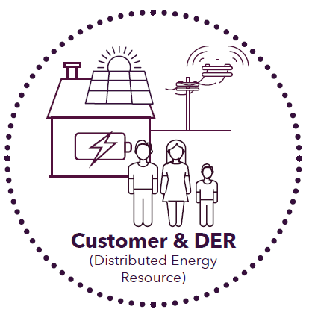
Household Consumers: Policy considerations and status
Affordability of energy and access to competitive markets
VPP demonstrations proven successful and will add to competition in FCAS.
Empowering consumer participation in a two-way market and system
Work currently being progressed by ESB P2025 program.
Equitable DER benefits sharing framework
AEMC’s Access & Pricing Rule Change
Demand response
WDR Mechanism to commence Oct 21
Emergency response
Working through Min Demand issues
Access and connections of DER
DER market trials in Vic and WA
Question: What other consumer-related factors should we consider?

Slide 25
Upcoming opportunities for consumer engagement with AEMO’s DER Program
DER Demonstrations
Standards and Connections
Markets and Frameworks
Vic
Vic
Vic
DER Demonstrations – stakeholder working groups are currently being established. More info on AEMO’s website, once confirmed.
DEIP Standards, Data and Interoperability working group and DEIP DER Device Standards Taskforce – contact DERSDI@aemo.com.au to get involved.
Refer COAG Energy Council for post-2025 NEM market design working groups - http://www.coagenergycouncil.gov.au/energy-security-board/post-2025
WDR Guideline consultation is consulting on the development of WDR guidelines.
DER-aligned work: Electric Vehicles
WA DER Program
Vic
Vic
30 November – DEIP EV Standards Taskforce Working Group
30 November - DEIP EV Data Availability Taskforce Working Group
Refer WA Government DER Roadmap and AEMO’s WA DER Program webpage for consumer engagement opportunities.
WA Advocates for Consumers of Energy forum (Office of Energy website)
For AEMO’s stakeholder engagement calendar, visit:
https://www.aemo.com.au/consultations/industry-forums-and-working-groups/calendar
Share feedback with DER Program team: DERProgram@aemo.com.au
Electric Vehicle team: electricvehicles@aemo.com.au
WA DER Program team: WADERProgram@aemo.com.au

Slide 26
Forum review project update

Slide 27
Other business & close

Slide 28
Wholesale Demand Response program update
AEMO Consumer Forum, 25 November 2020

Slide 29
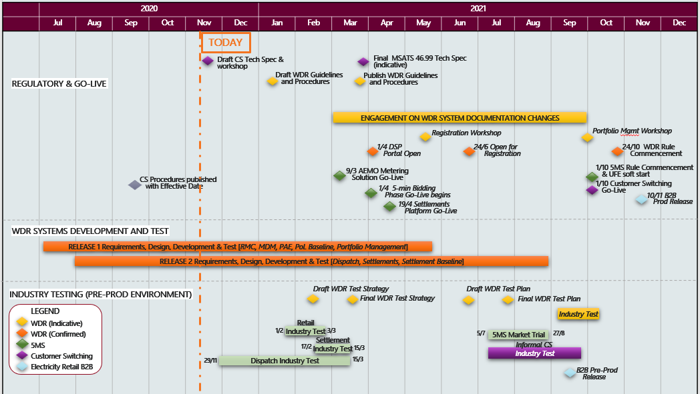
Indicative program schedule
**Current as of 16 Nov 20**

Slide 30
Engagement since last Consumer Forum
**All meeting packs and notes can be found here:
https://aemo.com.au/consultations/industry-forums-and-working-groups/list-of-industry-forums-and-working-groups/wdr
 | DATE | FORUM | PURPOSE/CONTENT
August | 11 Aug 20 | WDR Technical Working Group #1 | Forum for discussing technical matters relating to the development of the WDR Guidelines
 | 18 Aug 20 | WDR Consultative Group #3 | AEMC session on approach to WDRU dispatch Approach to dispatch compliance Introduction to baselining
September | 08 Sep 20 | NEM Consultative Forum | Program update provided
 | 22 Sep 20 | WDR Consultative Group #4 | Overview and approach to DRSP registration, WDRU classification and aggregations WDR scenarios
October | 01 Oct 20 | Joint 5MS/WDR forum | Discussion on concurrent implementation of 5MS, customer switching and WDR
 | 12 Oct 20 | WDR Technical Working Group #2 | Forum for discussing technical matters relating to the development of the WDR Guidelines
 | 20 Oct 20 | WDR Consultative Group #5 | Update on WDR procedures and guidelines consultations Debrief on 5MS/WDR concurrent implementation
 | 26 Oct 20 | WDR/DNSP workshop | Forum for sharing information on and discussing potential WDR impacts on distribution networks.
November | 06 Nov 20 | WDR/Retail workshop | Workshop to test the retail procedures against a WDRU NMI lifecycle (creation to de-energisation and extinction).
 | 17 Nov 20 | WDR Consultative Group #6 | Introduction to WDR settlement reports​ Introduction to the Portfolio Management System​ Approach to market testing​ Engagement on systems documentation​ WDR compliance

Slide 31
Upcoming WDR meetings
WDR Portfolio Management System walkthrough
  Timing: 2:30pm – 4:30pm AEDT, Thu 26 November
  Purpose: Detailed Portfolio Management System walkthrough and questionnaire with participants.
  Nominations: to wdr@aemo.com.au by Fri 20 Nov
DNSP workshop #2
  Timing: 10:30am – 12:30pm AEDT, Fri 11 December
  Purpose: Forum for sharing information on and discussing potential WDR impacts on distribution networks.
WDR Consultative Group
  Timing: 10:00am – 1:00pm AEDT, Tue 15 Dec

Slide 32



WDR contact and information
Mailbox
wdr@aemo.com.au
WDR program information
https://aemo.com.au/initiatives/trials-and-initiatives/wholesale-demand-response-mechanism
WDR stakeholder engagement options
https://aemo.com.au/consultations/industry-forums-and-working-groups/list-of-industry-forums-and-working-groups/wdr

Slide 33
Indicative WDR procedure change timelines
Procedure package | Consultation Paper | Round 1 Consultation | Draft | Round 2 Consultation | Final
WDR Guidelines | Thu 22 Oct 2020 | Fri 27 Nov 2020 | Thu 14 Jan 2021 | Fri 12 Feb 2021 | Thu 25 Mar 2021
Settlements and Prudentials procedure – CLP | Fri 04 Sep 2020 | Fri 16 Oct 2020 | Fri 13 Nov 2020 | Fri 04 Dec 2020 | Fri 15 Jan 2021
Settlements and Prudentials procedure - Estimations | Thu 05 Nov 2020 | Fri 18 Dec 2020 | Fri 15 Jan 2021 | Thu 04 Feb 2021 | Thu 04 Mar 2021
Retail procedures & B2B guide | Mon 12 Oct 2020 | Tue 17 Nov 2020 | Tue 15 Dec 2020 | Tue 02 Feb 2021 | Tue 16 Mar 2021
Market & System Operations procedures | Fri 09 Oct 2020 | Tue 17 Nov 2020 | Fri 11 Dec 2020 | Fri 29 Jan 2021 | Fri 12 Mar 2021
Demand-side participation information guidelines | Wed 26 Aug 2020 | Wed 30 Sep 2020 | Wed 11 Nov 2020 | Wed 25 Nov 2020 | Fri 18 Dec 2020
Baseline Eligibility, Compliance and Metrics Policy | Early Dec 2020 | Jan 2021 | Feb 2021 | Mar 2021 | Apr 2021

Slide 34
WDR project and system documents:
Indicative change timelines
Area | Document | Early version released​ | Comments due | Updated version published​
DISPATCH COMPLIANCE | Post-event dispatch compliance framework | Jan 2021 | Feb 2021 | Apr 2021
TESTING | WDR Test Strategy | Feb 2021 | Mar 2021 | Mar 2021
 | WDR Test Plan | Jun 2021 | Jul 2021 | Jul 2021
WHOLESALE – EMMS | EMMS Technical Specification | Mar 2021 | Apr 2021 | Apr 2021
 | EMMS Data Model (DM) Report | Aug 2021 | Sep 2021 | Sep 2021
 | Data Interchange (DI) online help | Aug 2021 | n/a | Sep 2021
 | Guide to Portfolio Management System (PMS) | Apr 2021 | Apr 2021 | May 2021
 | Markets Portal online help (PMS updates) | Apr 2021 | Apr 2021 | May 2021
 | Portfolio Management API Technical Specification* | Jul 2021 | Aug 2021 | Sep 2021
 | Portfolio Management API Guide* | Jul 2021 | Aug 2021 | Sep 2021
RETAIL – MSATS/eMDM | MSATS Technical Specification | Apr 2021 | Apr 2021 | May 2021
 | New/Updated MSATS/eMDM guides | Jun 2021 | Jul 2021 | Sep 2021

