Slide 1
5MS Systems Working Group
SWG#5 - Monday, 17th December 2018
AEMO Offices:
Level 9, 99 Gawler Place, Adelaide
Level 10, 10 Eagle Street, Brisbane
Level 22, 530 Collins Street, Melbourne
Level 2, 20 Bond Street, Sydney
WebEx: http://aemo.webex.com
ACCESS CODE: 577 849 490 PASSWORD: p3f83433

Slide 2
Agenda (Melbourne Time)
NO | Time | AGENDA ITEM | Responsible
Preliminary Matters
 | 10:00am - 10:05am | Welcome, introduction and apologies | Hamish McNeish (AEMO)
Matters for Noting
 | 10:05am – 10:15am | Minutes and Actions from last meeting | Hamish McNeish (AEMO)
 | 10:15am – 10:20am | System workstream update | Hamish McNeish (AEMO)
Matters for Discussion
 | 10:20am – 10:40am | Dispatch Focus Group Update | Pierre Fromager (AEMO)
 | 10:40am – 11:00am | Settlement Focus Group Update | Scott Maskiel (AEMO)
 | 11:00am – 11:10am | Global Settlement Final Rule | Hamish McNeish (AEMO)
 | 11:10am – 11:30am | Retail 1 MB file size increase feedback | Hamish McNeish (AEMO)
 | 11:30am – 11:40am | Systems High Level Impact Assessment (HLIA) feedback | Hamish McNeish (AEMO)
 | 11:40am – 11:45am | FTP Account Access | Hamish McNeish (AEMO)
 | 11:45am – 11:50am | Data Model Database Support | Hamish McNeish (AEMO)
Other business
 | 11:50am – 12:00pm | General questions | Hamish McNeish (AEMO)
 | 12:00pm – 12:05pm | Forward meeting plan | Hamish McNeish (AEMO)

Slide 3
Items for Noting
Hamish McNeish

Slide 4
Current Actions
Meeting notes with actions have been emailed and published
Any feedback?
Item | Topic | Action required | Action Update | Responsible | By
1.6 | Participant bandwidth implications | AEMO to provide assessment on bandwidth/networking impacts. |  | AEMO | 17/10/2018
2.5 | Retail 1 MB file limit increase | AEMO requested participants to review their own systems for constraints or issues to support a 10 MB raw file limit and provide feedback. | Received feedback will be discussed today. | Participants | 21/11/2018
3.1 | Bidding JSON format usage for APIs | AEMO to include bidding APIs in focus group discussion, date to be scheduled. | 27th Nov – Dispatch Focus Group focused on APIs – Debrief provided today | AEMO | 17/12/2018
3.2 | Bidding data model transition | AEMO to include in data model focus group discussion, date to be scheduled. | Proposed for Feb-19 | AEMO | 17/12/2018
3.3 | Bidding data model tables | AEMO to include in data model focus group discussion, date to be scheduled. | Proposed for Feb-19 | AEMO | 17/12/2018
4.1 | API call timeout | AEMO to provide how the APIs will support dealing with a submission that gets no valid response e.g. in the case of a timeout | Proposed options and AEMO’s preference discussed today | AEMO | 17/12/2018
4.2 | Data Model Database Support | AEMO to provide information on additional database support | Proposed options and AEMO’s preference discussed today | AEMO | 17/12/2018
4.3 | Avoid clashes with MSUG | AEMO to ensure no clashes with planned MSUGs | MSUGS added to forward schedule for visibility | AEMO | 17/12/2018
4.4 | B2M APIs | AEMO to confirm if B2M APIs will be included in 5MS | Yes B2M APIs for NMID, CATS, MTRD will be part of the 5MS changes | AEMO | 17/12/2018

Slide 5
Actions to Close
Item | Topic | Action required | Action Update | Responsible | By
3.2 | Bidding data model transition | AEMO to include in data model focus group discussion, date to be scheduled. | Proposed for Feb-19 | AEMO | 17/12/2018
3.3 | Bidding data model tables | AEMO to include in data model focus group discussion, date to be scheduled. | Proposed for Feb-19 | AEMO | 17/12/2018
4.3 | Avoid clashes with MSUG | AEMO to ensure no clashes with planned MSUGs | MSUGs added to forward schedule for visibility | AEMO | 17/12/2018
4.4 | B2M APIs | AEMO to confirm if B2M APIs will be included in 5MS | Yes B2M APIs for NMID, CATS, MTRD will be part of the 5MS changes | AEMO | 17/12/2018

Slide 6
System Workstream
Current Status
Dispatch and settlement streams
  In requirements phase
  Build of Development and test environments in progress
  Development and test resource confirmed
  Development expected to start late January 2019
Retail stream
  In requirements phase
  Recommended Solution to be tabled with Steering Committee December 2018
  Development environment confirmed
  Development expected to start February 2019
IT Schedule
  Detailed schedule build work continues
  Targetting to set a minimum 90 day baseline by January 2019

Slide 7
System Workstream - Metering
Current estimated timeline

Slide 8
System Workstream - Dispatch
Current estimated timeline

Slide 9
System Workstream –
Settlement and Operations
Current estimated timeline

Slide 10
Matters for Discussion
Hamish McNeish

Slide 11
Debrief on dispatch focus group (27 Nov 2018)
Pierre Fromager

Slide 12
Topics discussed at the workshop
Break-up rebid explanation field into two or four fields.
Bidding interfaces
Improvements to Web UI
  Compressed view
  Targeted updates: fields and ranges
  Extract and upload to and from CSV
  Show LF adjusted prices.
  Running totals
  Multiple-offer submissions
  Multi-participant listings
API Interface

Slide 13
Rebid Explanation - Outcomes
AEMO Proposal | Discussion
Split the single REBIDEXPLANATION field into four fields: two mandatory fields in line with NER requirements two optional fields in line with AER guidelines | AEMO understands that industry preference is to maintain the status quo. AEMO believes that the REBIDEXPLANATION field currently performs too many functions and the status quo is not appropriate. Preferred approach provides flexibility and incremental cost is considered small when implemented as part of 5MS.
Outstanding issues | Outcomes | Next Steps
Transition from old format. | Acceptance that systems are changing anyway and this represents small extra cost. | AEMO internal review and design Draft Technical Specifications

Slide 14
Bidding interfaces –
Topic Outcomes
AEMO Proposal | Discussion
Proposed bidding interfaces include: API using JSON format Web UI with improved functionality Web file submission (JSON format) FTP (JSON format) | Why is FTP still supported? AEMO perceived this to be necessary to support the transition path to APIs. Other FTP interfaces are still in operation.
Outstanding issues | Outcomes | Next Steps
None | No strong objections from participants. Strong support for use of JSON format. | AEMO internal review and design Draft Technical Specifications

Slide 15
Improvements to Web UI –
Topic Outcomes
AEMO Proposal | Discussion
Improvements include: Compressed view Targeted updates: fields and ranges Extract and upload to and from CSV Show LF adjusted prices. Running totals Multiple-offer submissions Multi-participant listings Common list functionality Graphs (especially FCAS trapezium) | Page loading can be slow No support for submission of CSV (JSON exclusive) – discussed conversion from CSV to JSON. Requested submission identification such as a reference field use of wild-cards in reference and explanation fields context-sensitive help Multi-offer submissions Multi-participant ID view Suggestions: enter value for a ‘window’, default availability to remainder, copy/paste from MS Excel, shade TIs in the past. Support for graphs No support for offer comparisons
Outstanding issues | Outcomes | Next Steps
AEMO needs to consider effort in developing these. Compromise between extent of functionality and frequency of use. | Strong support for these improvements. | AEMO internal review and design Draft Technical Specifications

Slide 16
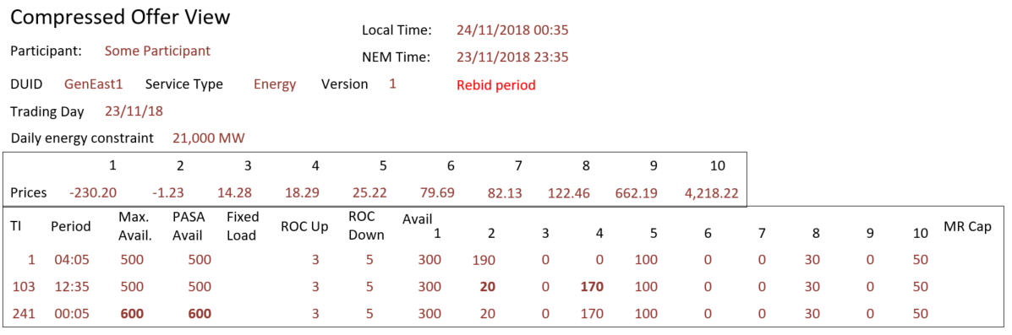
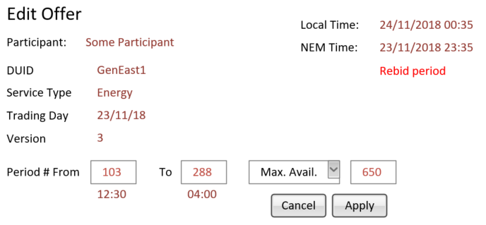
Web user interface

Slide 17
API interface –
Topic Outcomes
AEMO Proposal | Discussion
New bidding APIs via AEMO’s e-Hub | Further automated rebidding is planned by some participants. No support for partial or targeted offer updates. Requested roadmap for migration of other AEMO services to APIs. Consider combining viewSubmission and viewResponse APIs Consider new API technologies like GraphQL
Outstanding issues | Outcomes | Next Steps
Confirming of compression support | Strong support for APIs. | AEMO review and design Draft Technical Specifications

Slide 18
API interface
Provision of new bidding APIs via AEMO’s e-Hub
The Web user interface will use the APIs and participants may change their systems to use the same APIs directly
This interface will offer additional functions such as returning lists of offers, details of these offers and details of submissions.
Its advantages over FTP (the current process) are
  it will be synchronous returning a response that completes the transaction
  it will be faster because there is no time lost in polling directories
  the interface request and response are clearly defined and easier to develop and test against
API = Application Programming Interface
“A set of functions and procedures that allow the creation of applications which access the features or data of an operating system, application, or other service.”

Slide 19
Bidding APIs
API resource | Purpose | Parameters
POST /submitBids | Submit JSON bid format to AEMO | None
GET /listBids | List effective bids for a trading day range. OfferDateTime, TradingDay, DUID, Service, EntryType (Rebid/Daily), VersionNumber Provides the data in BIDDAYOFFER | From To <optional> DUID <optional> Service <optional>
GET /viewBid | View bid: Return effective (or specific bid version) in JSON bid format Provides the data for a bid in BIDDAYOFFER/BIDPEROFFER | Trading Day DUID Service OfferDateTime <optional>
GET /listSubmissions | List submissions based on a calendar date range. PID, OfferDateTime, Status, Authorised By, Authorised Date, Transaction ID Provides the data for a bid in BIDOFFERFILETRK | From To <optional>
GET /viewSubmission | View submission: Return JSON payload as submitted Currently only available via FTP | Transaction ID
GET /viewResponse | View submission response: Return JSON response Currently only available via FTP | Transaction ID

Slide 20
Debrief on settlements focus group (26 Nov 2018)
Scott Maskiel

Slide 21
Settlements Focus Group: Monday 26 November, Melbourne
Good engagement and contributions
21 attendees representing mainly retailers
Meeting notes and actions distributed to focus group, PWG and SWG on Thursday 6 December
Next focus group will be held as required, likely in Q1 2019
  Impacts to invoicing/statements are still a work in-progress, and likely to require further consultation

Slide 22
Topics Discussed at the Settlements Focus Group
Overview of settlement implications of 5MS
Update on consultation approach:
  Settlement Revisions – First stage consultation will commence 14 December 2018 and will end 21 January 2019
  Settlement Estimations – First stage consultation underway and will end 21 January 2019
  Credit Limit Procedure – Delayed to commence after consultation of the reallocations procedure
Changes to the Reallocations procedure
Transition to 5MS
AEMO Settlement Interfaces
  Data interchange
  APIs
  Publication of UFE

Slide 23
Transitional billing arrangements
- Topic Outcomes
AEMO Proposal | Discussion
Currently under development | Some participants expressed a preference for separate reports during the billing week when the 5MS transition occurs on 1 July 2021. AEMO is evaluating the cost/benefits of building a system solution to support a one-off transitional arrangement. Further investigation required if having separate invoices/reports will be Rules compliant.
Outstanding Issues | Outcome | Next Steps
Participants to provide feedback on billing and reporting transitional arrangements during the billing week when the 5MS transition occurs on 1 July 2021 | Pending | Feedback from participants due 16 January 2019

Slide 24
Approach to support reallocations after 5MS
- Topic Outcomes
AEMO Proposal | Discussion
Reallocations interface to be capable of processing 5-minute reallocations 6 months prior to July 2021. 5-minute reallocations interface to be available in pre-production by mid 2020 for market participant testing. Market participants to be restricted from inputting 30-minutes reallocations for any time periods beyond 1 July 2021. | Participants had a preference for the reallocations system to be capable of processing 5 minute reallocations 6 months prior to July 2021, with pre-production available mid-July 2020. Agreement that there is minimal value in supporting 30 minute reallocations past July 2021 if sufficient time is given to participants to enter 5 minute reallocation contracts before July 2021.
Outstanding Issues | Outcome | Next Steps
AEMO investigating workplan to confirm commitment to delivery timeframe | Pending | AEMO to consider the optimal timeline for allowing for input of 5 minute reallocations. To report back at next Settlement Focus Group.

Slide 25
Updates to the Reallocations user interface
- Topic Outcomes
AEMO Proposal | Discussion
New interface will support 288 input fields to accommodate more trading intervals as a results of 5MS. Features such as copy/paste and fill functions are in plan to ease user access | Participants suggested that a notifications feature would be of value. Additional thought required as to which format will suit best (Email/Push notifications) Discussion regarding additional functionality to report on net reallocations
Outstanding Issues | Outcome | Next Steps
Participants to provide further suggestions to improve current reallocations user interface and functionality, including preferences for file uploading | Pending | Feedback from participants due 16 January 2019

Slide 26
Data interchange
– Topic Outcomes
AEMO Proposal | Discussion
AEMO is proposing that 5-minute settlement DI reports will use the same table names and structures as existing 30-minute feeds, with the definition of “PeriodId” changing from a 30-minute period (1 to 48) to a 5-minute period (1 to 288). AEMO proposed providing a 30 minute legacy feed to ease transition | Participants agreed that 5 minute data feed is preferred after 1 July 2021, a 30 minute legacy feed is not required Some participants also expressed that there could be value in retaining data in the DI archive for more than 6 months
Outstanding Issues | Outcome | Next Steps
Participants to provide feedback on AEMO’s approach of retaining the same table names and structures, and what types of data should be retained in the DI archive for more than 6 months | Pending | Feedback from participants due 16 January 2019

Slide 27
API Services
- Topic Outcomes
AEMO Proposal | Discussion
The proposed approach for 5MS is to always provide an accompanying API where a significant change to a web application occurs in the EMMS Markets Portal. Other API’s will be considered on a case-by-case basis for functions that are considered high-value to the industry | AEMO noted that Settlement Web applications likely to be affected by 5MS are Reallocations and the Prudentials dashboard Settlements Direct and NMAS offers are also under active consideration
Outstanding Issues | Outcome | Next Steps
Participants to provide feedback on what other functions would benefit from API services | Pending | Feedback from participants due 16 January 2019

Slide 28
Global Settlement Final Rule
Hamish McNeish

Slide 29
Global settlement implementation timeline
1 December 2019
AEMO procedures updated for both 5MS and GS
1 July 2021
5MS begins
AEMO starts publishing UFE data (‘soft start’)
6 February 2022
GS begins
1 March 2022
AEMO’s first annual report on UFE trends
New procedure required
[NER 3.15.5(d) and 11.112.5]
New annual report
[NER 3.15.5B] and new reporting guidelines [NER 3.15.5B(d) and 11.112.6]

Slide 30
Comparison of AEMO’s proposal and the draft and final rules (1)
ISSUE | AEMO PROPOSED RULE | DRAFT RULE | FINAL RULE
Implementation timeframes | Broadly align implementation with that of five minute settlement. | Implement the rule on the same timeframes as five minute settlement, including procedure and guideline changes (1 Dec 2019) and the commencement date (1 Jul 2021). Add a compulsory soft start for global settlements, starting twelve months prior to commencement (1 Jul 2020). | Align AEMO procedural and guideline changes with those of five minute settlement. Commence the global settlement soft start at the same time as five minute settlement commencement (1 Jul 2021). Mandatory information provision for the two changes aligned. Financial start of global settlement approximately 7 months after soft start (6 Feb 2022)
Who and how to allocate UFE | All market customers (i.e. retailers) in proportion to their share of the loss- adjusted consumption within the area. | No change | No change
At what level should UFE be allocated? | UFE to be allocated at the transmission connection point level. | UFE to be allocated at the local area (i.e. DNSP network) level. | No change

Slide 31
Comparison of AEMO’s proposal and the draft and final rules (2)
ISSUE | AEMO PROPOSED RULE | DRAFT RULE | FINAL RULE
Treatment of VTNs | Remove the ability for network businesses to assign customers to VTNs. A range of options proposed to facilitate their removal. | VTNs are retained for settlement purposes and there is no change to the VTN policy arrangements. | No change
Information requirements | N/A. With the allocation of UFE at the TNI, no additional requirements were proposed. | Require mapping of NMIs to TNI to allow for reporting of UFE at the TNI level. AEMO also required to conduct technical studies if requested when UFE exceeded a threshold within a TNI. | Removal of the requirement in the draft rule for NMIs to be mapped to TNIs and technical studies to be undertaken where UFE exceeds an AEMO defined threshold. AEMO to introduce a UFE reporting and analysis framework. To be developed through consultation with industry.
Unmetered loads | AEMO proposed two options for the treatment of unmetered loads under global settlement which would avoid all retailers being incorrectly charged for this energy. | The energy associated with off-market (i.e. non-type 7) unmetered loads is to be explicitly included in AEMO’s settlement processes. AEMO is to include in its metrology procedures guidance on how this should occur. | Minor changes from draft rule. As a result of the information requirements changes (described in the row above), NMIs will not be required to be allocated to TNIs within VTNs. More flexibility is also provided to AEMO

Slide 32
Global Settlement
Key Points
  UFE to be allocated at the local area (DNSP network/Profile Area) level
  NMI to TNI mapping - for off-market, unmetered loads - not required to be provided to AEMO
  AEMO to introduce a UFE reporting and analysis framework
  UFE published from 1 July 2021
  Global Settlement starts from 6 Feb 2022 (start of a billing week)
System Impacts
  Final decision largely aligns to AEMO’s planned system change
  Changes to UFE allocation level
  UFE publication already included in both Retail and Settlement streams
    Retail – Publish UFE factors (from 1 July 2021)
    Wholesale - Publish UFE allocation to participants (from 1 July 2021)

Slide 33
Retail 1 MB Message Size Increase Feedback
Hamish McNeish

Slide 34
Received Feedback (1 of 2)
Participant | Support increase from 1 MB | Significant System Issues? | Identified Issues
AEMO | Yes | None identified | Bandwidth concerns - APIs in the B2B gateway don’t currently support compressed payloads
EnergyQ | Yes | Yes | 10 MB meter data message failed processing 5 MB some issues, and took longer to process – requires volume testing To support 5 MB or 10 MB will require system change, but this is achievable in the 5MS timeframes.
Ergon | No – major investment would be required | Yes | 10 MB failed to process for billing and settlement processes 5 MB failed to process for settlements processes 2 MB failed to process in settlements processes
Plus ES | Yes | None identified | No issues foreseen
Origin | Yes | Analysis still to be done | Origin recommend considering it as X for time being and gradually increasing the number during the Test Phase and validating the right number that is acceptable for all participants. Origin noted the following key constraints: 1. AEMO is moving into API based protocol which is HTTP based. HTTPS based protocol do drop out when the volume of data increase. This needs to be considered when increasing the size. 2. Are other participants looking at the possibility of compression? What is the overall view and possibility to adopt compression?

Slide 35
Received Feedback (2 of 2)
Participant | Support increase from 1 MB | Significant System Issues? | Identified Issues
Origin | Yes | Analysis still to be done | Origin recommend considering it as X for time being and gradually increasing the number during the Test Phase and validating the right number that is acceptable for all participants. Origin noted the following key constraints: 1. AEMO is moving into API based protocol which is HTTP based. HTTPS based protocol do drop out when the volume of data increase. This needs to be considered when increasing the size. 2. Are other participants looking at the possibility of compression? What is the overall view and possibility to adopt compression?
AGL | Yes | Likely as size increases | Draft thoughts AGL notes that while larger files can now be transported, the issues which arise with larger files are the processing to open, validate and respond to content. An initial consideration was that a 2MB file will not impact processing, whereas a 10 MB file will impact processing. AGL suggests that the consideration of file size should be both a matter of how much content can be transported efficiently and how much processing and response is needed to deal with larger files. Undoubtedly there is a point where the trade-offs between efficiency of transported file and processing of a larger file can be brought together so that the efficiency of overall process is maximised.

Slide 36
High-Level Impact Assessment Document (HLIA) - Feedback
Hamish McNeish

Slide 37
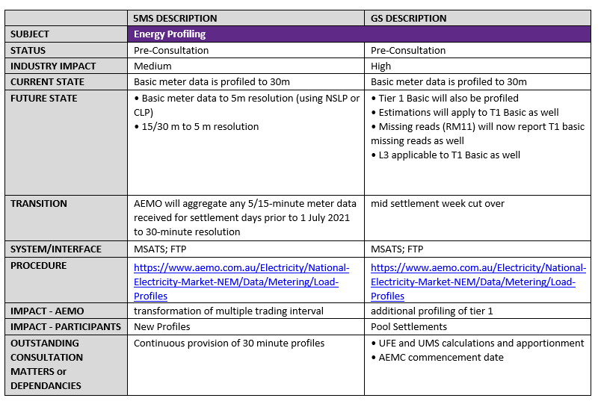
Systems HILA – Feedback (1)
Feedback received from 2 participants – ERGON, AusNet Services
Consider adding Gantt Chart for 5MS
Complete to do/TBC items, and add Global Settlement impacts
Add dependencies, and proposed table format to better format information, i.e.

Slide 38
Systems HILA – Feedback (2)
Section 3.3.2, 3.4.2 – Meter Data Format, Standing Data Changes
  Concerns raised on required standing data updates, requiring bulk updates
  Similar concerns were raised at the last Metering Focus Group, AEMO has taken this on board and will provide a new approach at the next Metering Focus Group.
Section 3.5 – Meter Data Interfaces
  Concern raised about using an MDMT style acknowledgement of MDFF B2B files
  AEMO’s intent is to align as much as possible to the B2B processes. More discussion may be required to understand the issue.

Slide 39
FTP Account Access
Hamish McNeish

Slide 40
AEMO FTP Account Policy
By default all Participants are given one account that has access to both pre-production and production
There is no restriction on requesting a second account, these account will also have access to both pre-production and production
Participants usually put in a _pre or pre_ to designate an account for preproduction
Looking at support tickets there has been some confusion on the default versus our standard/policy e.g. “AEMO only ever issues one NEMNet account as per the AEMO standard”.
This issue has been raised to our Support Hub.

Slide 41
Data Model Database Support
Hamish McNeish

Slide 42
Current AEMO Support
AEMO currently supports:
  pdrLoader and pdrBatcher latest version 7.4.1 (released 22 Nov 2018)
  pdrLoader 7.4.0 and 7.4.1 officially supports:
    JRE 8
    SQL Server 2014, 2012
    Oracle 12c, 11g
Other database support - Azure SQL, PostgreSQL, MySQL:
  We offer no official support, this is provided as best endeavours
  pdrLoader and our data model scripts are not tested against these databases
  Example configurations for connecting to alternate databases are provided in the pdrLoader properties file (MySQL and PostgreSQL)
  There are installations on these databases being used by participants
    Azure SQL and SQL server scripts are identical
    The Oracle scripts can be converted to PostgreSQL using third party tools

Slide 43
General Questions
Hamish McNeish

Slide 44
Forward Meeting Plan
Hamish McNeish

Slide 45
Upcoming Meetings
Systems Working Group
  TBC January 2019
    Schedule update
    Demo of pdrMonitor
    Data Model report delivery analysis
  Mon, 18 February 2019
Focus groups:
  Dispatch – mid-Feb-19 - tentative
  Metering, Settlement – to be scheduled
Other AEMO IT Meetings
  MSATS MSUG - 19 Dec 2018 (Initial) - tentative
  EMMS MSUG - 17 Jan 2019 (Post Release)
  MSATS MSUG – 13 Feb 2019 (Post Release) - tentative
5MS Meetings and Forum Dates: http://aemo.com.au/Electricity/National-Electricity-Market-NEM/Five-Minute-Settlement

