Slide 1
5MS/GS Transition Focus Group #14:
Thursday 15th April 2021
WebEx only [details in calendar invitation]
**Please disconnect from your workplace VPN for the WebEx call**
PLEASE NOTE THIS MEETING WILL BE RECORDED FOR THE PURPOSE OF PREPARING MINUTES

Slide 2
AEMO Competition Law Meeting Protocol
AEMO is committed to complying with all applicable laws, including the Competition and Consumer Act 2010 (CCA). In any dealings with AEMO regarding proposed reforms or other initiatives, all participants agree to adhere to the CCA at all times and to comply with this Protocol. Participants must arrange for their representatives to be briefed on competition law risks and obligations.
Participants in AEMO discussions must:
Ensure that discussions are limited to the matters contemplated by the agenda for the discussion
Make independent and unilateral decisions about their commercial positions and approach in relation to the matters under discussion with AEMO
Immediately and clearly raise an objection with AEMO or the Chair of the meeting if a matter is discussed that the participant is concerned may give rise to competition law risks or a breach of this Protocol
Participants in AEMO meetings must not discuss or agree on the following topics:
Which customers they will supply or market to
The price or other terms at which Participants will supply
Bids or tenders, including the nature of a bid that a Participant intends to make or whether the Participant will participate in the bid
Which suppliers Participants will acquire from (or the price or other terms on which they acquire goods or services)
Refusing to supply a person or company access to any products, services or inputs they require
Under no circumstances must Participants share Competitively Sensitive Information. Competitively Sensitive Information means confidential information relating to a Participant which if disclosed to a competitor could affect its current or future commercial strategies, such as pricing information, customer terms and conditions, supply terms and conditions, sales, marketing or procurement strategies, product development, margins, costs, capacity or production planning.

Slide 3
Agenda **Please disconnect from your workplace VPN for the WebEx call**
NO | Indicative Time | AGENDA ITEM | Responsible
1 | 10:30 - 10:40 | Welcome and introduction | Greg Minney
2 | 10:40 - 11:00 | MSDR Data Transition WG Debrief | Blaine Miner
3 | 11:00 - 11:45 | CATS Transaction Analysis update | Blaine Miner/Paul Lyttle
4 | 11:45 - 12:00 | GLOPOOL planning | Paul Lyttle
5 | 12:00 - 12:10 | MTP Update | Blaine Miner
6 | 12:10 - 12:20 | Cross Boundary Supplies Guideline | David Ripper
7 | 12:20 - 12:30 | Next steps and general business | Greg Minney

Slide 4
Attendees (1/2)
Organisation​ | Attendee​ | Organisation​ | Attendee​
AEMO (Chair) | Greg Minney | Endeavour Energy | Dino Ou
AEMO | Anne-Marie McCague | Energex | Dannii Upham
AEMO | Blaine Miner | Energex | Steve Smith
AEMO | David Ripper | Energy Queensland | Nicole Bright
AEMO | Elizabeth Bernhardt | ERM Power | Sharleen Flanagan
AEMO | Paul Lyttle | Essential Energy | Alison Davison
AEMO | Peta Hatzikides | Essential Energy | Steve Blair
Actew AGL | Collette Reedy | Evoenergy | Jeff Roberts
Aurora Energy | Kevin Boutchard | Evoenergy | Luke Garrett
Ausgrid | Wayne Turner | Infigen | Natalie Junge
AusNet Services | Con Michailides | Intellihub | Rob Mcneur
Basslink | Greg Mather | IntelliHUB | Warren Van Wyk
Brave Energy | Trent Smith | Jemena | Joseph Lyttleton
Clean Co | Kristin Watkins | Jemena | Leon Vilfand
CleanCo | Vicki Grant | Jemena | Rajiv Kumar Balasubramanian

Slide 5
Attendees (2/2)
Organisation​ | Attendee​ | Organisation​ | Attendee​
Mondo | Jay Summers | Stanwell | Adam Neilson
Mondo | Richard Metherell | Stanwell | Michael Flynn
PlusES | Linda Brackenbury | Stanwell | Rossi Mangano
Powercor | Arif Syarifuddin | Stanwell | Sudeshna Nanda
Powercor | Mark Pilkington | TasNetworks | Adrian Honey
Powerlink | Dean Knight | Transgrid | Adam Hoare
Powerlink | Karel Mallinson | United Energy | Christian Solis
Red / Lumo | Mark Reid | Vector Metering | Paul Greenwood
Red Dolphin Systems | Tony Stone | Yurika | Cindy Matthews
Red/ Lumo | Nick Gustafsson |  | Anthony Croce
SA Water | Andrew Wilkins |  | Dev Kanda
SAPN | David Woods
Secure Meters | Kam Vessali
Snowy Hydro | Audrey Follett
Snowy Hydro | Eileen Hayes
Snowy Hydro | Sandra Ho

Slide 6
Consolidated meeting actions
#​ | Action​ | Owner​ | Due Date​
14.1​ | TFG to provide feedback on the draft “Participant ID Update Plan” | TFG | 30 April
14.2 | TFG to provide feedback regarding proposed changes to the MTP (v1.8) | TFG | 30 April

Slide 7
MSDR Data Transition WG Debrief
Blaine Miner

Slide 8
MSDR Data Transition WG Debrief
AEMO hosted the first workshop on Tuesday the 30th of March
Attended by over 100 representatives from market participants
Workshop participants went through the MSDR changes field by field and were asked to provide initial feedback on:
Priority (high, medium and low)
Expected data volumes
Whether a “compliance holiday” was required
The proposed approach of using CRs to update that field
The slide presentation was updated during that meeting

Slide 9
MSDR Data Transition WG Debrief
Workshop #2 scheduled to be held on Friday April 30
AEMO’s preferred approach for the data transition is to use change requests where possible
AEMO recognises that it will take time for participants to provide all the data and as such recognises the need for a “compliance holiday” from the effective date until a date to be determined.
AEMO looks forward to receiving your feedback prior to the workshop as to:
AEMO’s proposed use of Change Requests
The length of time for the associated “compliance holiday”
How industry could best schedule the updates so that notification volumes are more manageable
Which field(s) should be updated first (and why)

Slide 10
MSDR Data Transition WG Debrief
Prior to the second workshop AEMO encourages Participants to:
Complete the spreadsheet circulated on 1 April
This will inform the discussion around the preferred method for data transition as well as the proposed compliance window.
Determine estimated CR volumes (including notifications) to help inform the discussions on the day
AEMO requests that this information be provided prior to the workshop to assist with prioritising the MSATS fields based on volumes of data (CR and Notifications) being rated highest to lowest
Send the information above to ercf@aemo.com.au by COB 23 April

Slide 11
Proposed RTC Transition Approach
By 1 Oct 2021
All Tranche 1 meters (type 1-3, subset of 4 and cross boundary) to have their RTC updated with a fourth character of ‘A’ or ‘D’ (de-energisation scenarios only)
From 1 Oct 2021 to 30 Nov 2022
All Tranche 2 meters (new and replacement type 4, 4A, VICAMI, etc.) to have their RTC updated with a fourth character of ‘A’ or ‘D’ (de-energisation scenarios only)
From 1 Dec 2022 onwards
All other meters (e.g. basic meters and MRIM) to have their RTC updated with a fourth character whenever a change is made to that meter that requires MSATS to be updated
Noting:
MPs can update RTCs to the appropriate 4 character code, resulting from BAU activities only, from 1 May 2021
‘Mass’ updating of this field should be discouraged without prior engagement with all affected parties
AEMO is not proposing any explicit transition end dates, at this stage, for non-tranche 1 and 2 meters

Slide 12
Notes
AEMO presented an overview of the first MSDR Data Transition WG meeting and reiterated AEMO’s request for information by 23 April in preparation for the second workshop.
In response to a participant query, AEMO reiterated that:
RTC updates relating to non-tranche 1 or tranche 2 meters are proposed to commence from 1 December 2022, noting the BAU/’single meter’ updates are permitted from 1 May 2021
From 1 Dec 2022 onwards
All other meters (e.g. basic meters and MRIM) to have their RTC updated with a fourth character whenever a change is made to that meter that requires MSATS to be updated

Slide 13
CATS Transaction Analysis update
Blaine Miner/Paul Lyttle

Slide 14
Scope
In-scope considerations:
By 31 Aug 2021
Convert type 1-3, subset type 4, type 7 and existing cross boundary datastreams to register level
Update type 1-3, subset type 4 and existing cross boundary connection point ReadTypeCodes to ‘A’ (or ‘D’ where applicable)
Create NCONUML and ‘new’ Cross boundary NMIs, Registers and Datastreams
Update NMI Classification codes, where required
Create/activate Basic meter 1st tier datastreams
Update VIC TUoS datastreams from 1-4 to ‘N’
By 30 Nov 2022
Update new and replacement type 4, 4A and VIC AMI meter ReadTypeCodes to ‘A’, where applicable
Out-of-scope items:
MSDR standing data updates
Other standing data updates associated to:
Market reform initiatives
Non-market based initiatives
E.g. Participant based activities/initiatives

Slide 15
5MS/GS Transaction Volume Analysis Update
March Rollout plans have been applied
Excellent response from participants
New template has been circulated for 1 May updates
Changes to the template includes:
Reporting at meter level for the first 3 plan types
Making Datastream conversion plans required vs optional
MDPs to provide metering data delivery plans for Tranche 1 meters
MPs to provide RTC plans for Tranche 2 meters
MDPs to include Net to Register datastream updates for T1 meters
Updates to Change Request multipliers have been updated to reflect participant feedback
Graphs now provide a more granular view
Note:
Participants should consider notification bundling.
Up to 500 notifications can be bundled into a single file.

Slide 16
Tranche 1 Definitions
Tranche 1
Meter types whose MTP activities are to be completed by 1 Oct 2021
Type 1-3 Replacement and Reconfiguration
Subset of type 4 meters Replacement and Reconfiguration - TNI, Market Generator or SGA
Cross Boundary meters NMI creation
Non-contestable unmetered loads NMI creation
Type 7 Reconfiguration
Note: Activation of Basic data streams are not included in the Tranche 1 numbers.

Slide 17
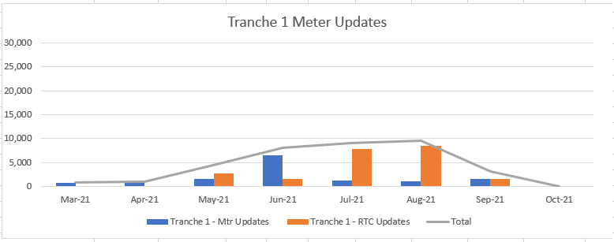
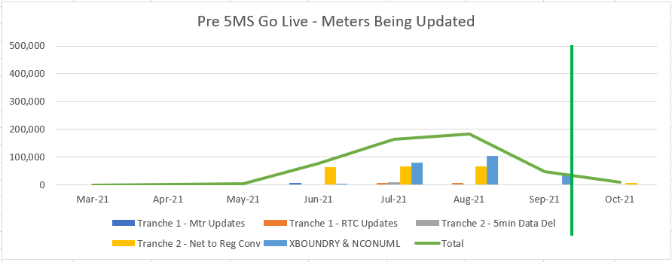
Tranche 1 Volumes
Consolidated Roll-out plan numbers
Tranche 1 - Meter updates Tranche 1 – NMI creations
Note: Graph ‘y’ axis = 30,000 Note: Graph ‘y’ axis = 60,000
Associated CR volumes:
Includes some Tranche 2 CRs
2 x CRs for NMI creations
Max Volume 185,000 (Aug-21)
74 Cross boundary NMIs
planned for post 5MS go-live
Note: Graph ‘y’ axis = 500,000

Slide 18
Tranche 2 Definitions
Tranche 2
Meter types whose MTP activities are to be completed by 1 Dec 2022
New and Replacement Type 4 from 1 Dec 2018
New and Replacement Type 4A from 1 Dec 2019
New and Replacement VICAMI from 1 Dec 2018
New and Replacement Sample from 1 Dec 2018

Slide 19
Tranche 2 Volumes
Consolidated Roll-out plan numbers
Tranche 2 – 5 min Data Delivery Tranche 2 – Net to Reg Conversions
Note: Graph ‘y’ axis = 400,000
Associated CR volumes:
Max Volume 420,000 (Dec-21)
MSDR volumes not included
2,500 Net to Reg conversions
planned for post 1 Dec 22
Note: Graph ‘y’ axis = 500,000

Slide 20
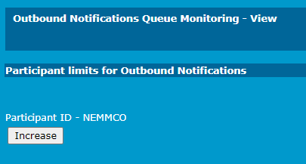
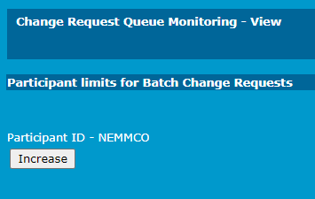
Notification and CR Limits
AEMO has had a number of enquiries relating to daily limit increases
Participants can increase there limits daily via the Menu Path:
Reports and Alerts > Query Monitoring >
Outbound Notification Queue Monitoring
Change Request Queue Monitoring
Selecting the Increase button within the window will double the participant limit for the day
A permanent change to participant limits must be requested via the AEMO Support Hub
Each request is assessed and prior to updating
Participants will be informed of limit changes

Slide 21
Notes
AEMO presented an overview of its latest round of CATS transaction volume analysis and explained how Participants can request increases to their MSATS Daily Limits via the MSATS Browser.
In response to participant queries, AEMO confirmed:
Its current assumptions regarding the creation of NCONUML MSATS standing data
That MSATS Daily Limit increases done via the MSATS Browser double the allowable volume for the current day only, can’t be used to increase limits for future dates

Slide 22
GLOPOOL Planning
Paul Lyttle

Slide 23
GLOPOOL Update
A draft “Participant ID Update Plan” has been included with this pack
Feedback requested by 30 April
This document describes the steps that will be taken to update the participant IDs to ‘GLOPOOL’
The document will not be formally consulted on, however participant comments are welcome
The document includes an estimated delivery time for each step
Where generic market details are to be provided an updated version will be published to capture the information
The next version of the document is scheduled for August 2021 and will include “confirmation of the process for back dated NMI creation”
Suggestions of scenarios are welcome from participants

Slide 24
Notes
AEMO presented an overview of the draft “Participant ID Update Plan” and requested feedback from TFG members regarding its content.
Action: TFG to provide feedback on the draft “Participant ID Update Plan”
In response to participant queries, AEMO confirmed:
The next version of the plan is currently scheduled to be released in August, with the final version scheduled for release in Jan 2022

Slide 25
MTP Update
Blaine Miner

Slide 26
MTP Update
Proposed Updates
Description | Date | Activity ID
Update TNI field to the TNI2 value for downstream NMIs associated to a cross boundary supply (new activity) | By 31 August 2021 | A97a
Provide AEMO estimated number of NMIs and associated energy volumes for each Unmetered Device category within calculation methodology (change in wording) | By 1 May 2021 | A89a
Activities Now Deemed Completed or Late
Description | Date | Activity ID
MCs to provide visibility of the approach / timeframe for required meter replacement or reconfiguration of ‘unknown’ cross boundary meters | By 31 March 2021 | A23
MCs to ensure that details of the Inventory Table, calculation methodologies and Agreed Loads are agreed prior to implementation by relevant Registered Participants | By 31 March 2021 | A87

Slide 27
Upcoming Transition End Date Activities
Description | Transition End Date | Activity ID
AEMO Metering Business to approve MDP NCONUML profiles/algorithms | By 1 May 2021 | A89
MDPs to provide AEMO estimated number of NMIs and associated energy volumes for each Unmetered Device category within calculation methodology | By 1 May 2021 | A89a
MCs to provide progress and amendments to forward plans for Type 1-3, subset of 4 and ‘known’ cross boundary meters to AEMO | By 1 May 2021 | A3a, A8a, A13a, A19a
MDPs to provide progress and amendments to forward plans for Type 1-3, subset 4, 4, 4A, VICAMI and Sample meters to AEMO | By 1 May 2021 | A52a, A58a, A64a, A70a
MDPs to provide progress and amendments to datastream conversion plans, to convert Net datastreams to register level | By 1 May 2021 | A32a, A37a, A42a, A52b, A58b, A64b, A70b, A82a
LNSPs to provide progress and amendments to Cross Boundary and NCONUMLs NMI Create plans | By 1 May 2021 | A95a, A99a
Participants to establish agreements to allow the delivery of 5min metering data pre 1 Oct 2021 between NSP, Retailer, MDP and AEMO, as applicable | By 31 May 2021 | A32, A37, A42, A47, A53, A59, A65, A71, A84, A88

Slide 28
Upcoming Transition Start Date Activities
Description | Transition Start Date | Activity ID
MPs able to update the Meter Read Type code (RTC) with four-character values, resulting from BAU activities | From 1 May 2021 | A4a, A9a, A14a, A20a
MDPs able to create/convert export and import Active (kWh) and Reactive (kVarh) energy datastreams, where applicable, in the CNDS table | From 31 May 2021 | A36, A40, A45, A51, A57, A63, A69, A75
Participants able to create cross-boundary NMIs, datastreams and registers | From 31 May 2021 | A95, A96, A97
Participants able to create NCONUML NMIs, datastreams and registers | From 31 May 2021 | A99, A100, A101
MDPs able to send 15 and 30min metering data via MDFF to AEMO | From 31 May 2021 | A94
LNSPs able to apply new NMI classification codes | From 31 May 2021 | A103, A105, A107, A109, A111, A113, A115
MDPs able to provide 5min metering data to AEMO (MDFF) (Export and import (active (kWh) and reactive (kVarh)) energy metering data as applicable) | From 21 June 2021 | A35, A41, A46, A50, A56, A62, A68, A74, A86, A92

Slide 29
Notes
AEMO presented an overview of the:
Proposed changes to the current MTP
Activities which are now deemed completed
Upcoming transition end date activities
Upcoming transition start date activities

Slide 30
Cross Boundary Supply Guideline
David Ripper

Slide 31
Cross Boundary Supply Guideline
Participant feedback requested clarification of aspects of the Guideline - these suggestions have been included in the Final version.
Also included changes that more clearly describe the process and information to be provided before modifying or creating a Cross Boundary connection point (section 3.2 and a new clause 3.1(d)).
Responsibility for the population of NMI attributes clarified in 3.3.1, 3.3.2, 3.3.3 and 3.3.4.
Guide to the Role of MC - added the last paragraph to section 2.2 where DBs intending to become MC for Cross Boundary connection points must be registered in that role.

Slide 32
Notes
AEMO presented an overview of the updates to the final Cross Boundary Guideline document.
In response to participant queries, AEMO confirmed:
It does not know how many TNI2 updates will be required as the underlying cross boundary information has not yet been provided to AEMO
Downstream NMIs from emergency cross boundary supplies do not need the TNI field updated to the TNI2 value
Expected outcomes related to various cross boundary scenarios
Action: AEMO to add an additional activity into v1.8 of the MTP to allow for the provisioning of TNI2 values by AEMO to DBs

Slide 33
Next steps and general business
Greg Minney

Slide 34
Next steps & general business
Industry Readiness Survey responses due today (15 Apr)
Next TFG scheduled for Thurs 13 May 2021
Agenda items for next meeting
Rollout plan updates
MSDR update
“Participant ID Update Plan” Feedback

Slide 35
Notes
AEMO reminded members that the latest Readiness Survey responses were due today 15 April.
A member asked if the TFG supported the provisioning of Register ID to Suffix alignment transactions in the rollout plans. No additional support was received from the TFG so the rollout plan templates will not contain this requirement.

Slide 36
Thank you for your attendance and participation!

