Slide 1
Five-Minute Settlement Program: Information Session 2
AEMO 5MS Program Team
Friday, 30 November 2018

Slide 2
Introduction, agenda & housekeeping
Agenda:
Questions can be submitted through the webinar, or via 5ms@aemo.com.au
Questions will be answered at the end
Item | Time | Topic | Responsible
 | 2:00 pm – 2:10 pm | Welcome and introduction | Chris Muffett (AEMO)
1 | 2:10 pm – 2:30 pm | 5MS rule recap | Chris Muffett (AEMO)
2 | 2:30 pm – 2:50 pm | GS rule overview | Emily Brodie (AEMO)
3 | 2:50 pm – 3:10 pm | Program update | Graeme Windley (AEMO)
4 | 3:10 pm – 3:20 pm | Procedures workstream update | Emily Brodie (AEMO)
5 | 3:20 pm – 3:30 pm | Systems workstream update | Hamish McNeish (AEMO)
6 | 3:30 pm – 3:40 pm | Stakeholder engagement update | Gary Eisner (AEMO)
7 | 3:40 am – 4:00 pm | Questions | Chris Muffett (AEMO
 | 4:00pm | Meeting close | Chris Muffett (AEMO)

Slide 3
Five-Minute Settlement rule recap
Chris Muffett

Slide 4
Current settlement arrangements
The NEM dispatch process determines an energy price every 5 minutes, however the energy market is only settled on the basis of 30-minute energy volumes
To accommodate the different timeframes, the “spot” price in the NEM is the average of 6 dispatch prices
This gives rise to the 5/30 minute problem
The AEMC considered that this is resulting in negative consequences for the wholesale market (which ultimately impacts consumers)

Slide 5
Five-minute settlement
The AEMC has determined that from 1 July 2021, the NEM will be directly settled using 5-minute prices (i.e. the current 5-minute dispatch price will become the trading or “spot” price)
To support this, metering will progressively change to 5-minute:
All type 1-3, type 7, and some type 4 connection points must be 5-minute prior to go-live
New meters installed after 1 December 2018 must be 5-minute capable
Bids/offers are also changing:
Scheduled participants must submit bids/offers with 5-minute granularity

Slide 6
Impact to participants
 | Prior to July 2021 | From July 20201
Generators / SGAs | Review/update procedures Review/update contracts Review/upgrade IT systems | Submit five minute granularity offers into the NEM
Large customers |  | Submit five minute granularity bids into the NEM
Retailers |  | Consider developing new products and services using 5 minute data to value dynamic generation / demand response for small and large consumers
Networks |  | Calculate charges for distribution services from either metering data or settlements ready data for type 4 meters Calculate type 7 unmetered loads on a 5 minute basis.
Metering coordinators | Upgrade types 1, 2 and 3 metering installations, and some type 4, to be capable of recording and providing five minute data. Ensure that new and replacement metering installations are capable of recording and providing 5 minute data Review/upgrade IT systems | By 1 December 2022 at the latest, ensure that all new and replacement metering installations record and provide 5 minute data
Metering data providers | Review/upgrade IT systems | By 1 July 2021, ensure that type 1, 2 and 3 and some type 4 metering installations record and provide five minute data. By 1 July 2021, ensure that type 7 unmetered loads are calculated on a five minute basis. By 1 December 2022 at the latest, ensure that all new and replacement metering installations record and provide 5 minute data
Information Exchange Committee | Consult and recommend to AEMO any changes to the B2B procedures

Slide 7
Global Settlement rule overview
Emily Brodie

Slide 8
Global Settlement
AEMO lodged a rule change to the AEMC, proposing that global settlement be implemented to replace settlement-by-difference in the NEM: https://www.aemc.gov.au/rule-changes/global-settlement-and-market-reconciliation
If the rule is made, the change will be accommodated in the 5MS program. It primarily involves:
The local retailer role no longer being required for settlement i.e. all retailers have the same settlement arrangements
AEMO requiring meter data for all connection points
AEMO calculating unaccounted for energy (UFE) which is recovered from retailers operating in each area
Draft determination and draft rule were published on 30 August
Final determination and final rule are expected to be published next Thursday, 6 December 2018

Slide 9
Global Settlement – overview of draft rule
NOTE: the following items relate to the draft Global Settlement rule and may be subject to change as a result of AEMC deliberations. Final rule is expected on Thursday, 6 December 2018.
UFE to be allocated at the local area (DNSP network) level
Virtual transmission nodes are retained. DNSPs using VTNs will need to provide more information to AEMO
Off-market unmetered loads (non-type 7) to be included in AEMO’s settlements processes
Alignment with 5MS:
Commencement on 1 July 2021
AEMO to update its relevant procedures by 1 December 2019
AEMO to be provided with NMI to TNI mapping
This will allow AEMO to calculate and publish UFE from 1 July 2020 (12 months prior to the GS rule commencing)
AEMO will engage through the PWG and SWG on the procedure and system impacts

Slide 10
Program update
Graeme Windley

Slide 11
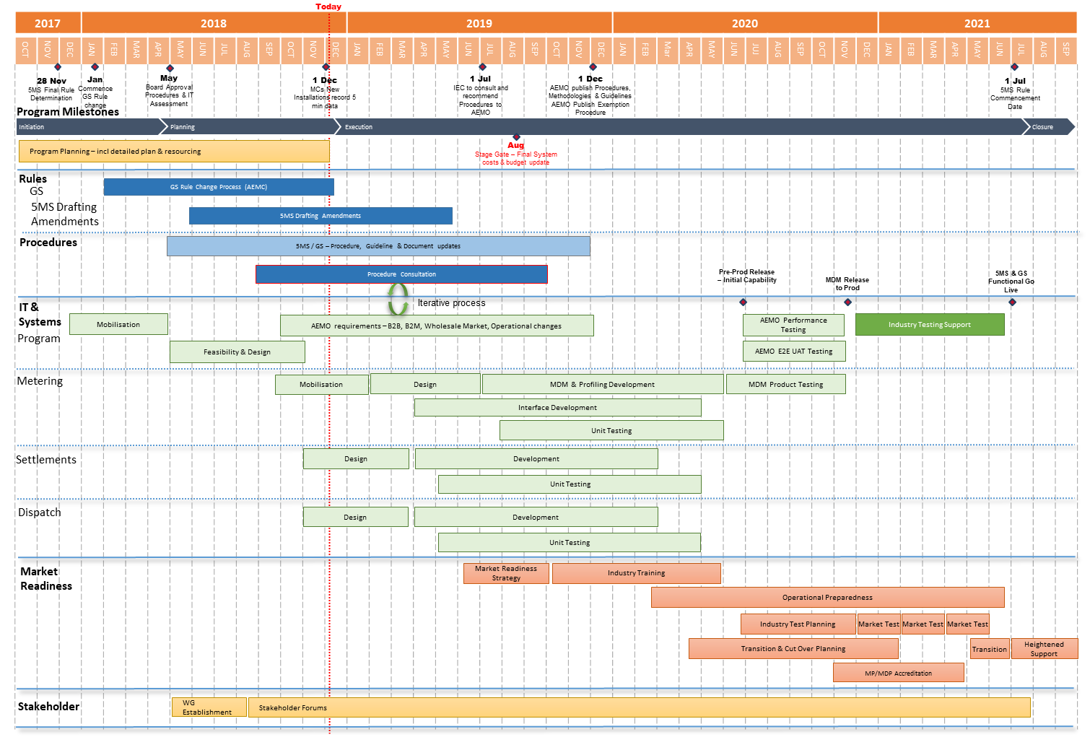
Program Conceptual Timeline

Slide 12
High-level status
Procedures work is progressing well, with most activities on track:
Working groups and focus groups have been constructive
Successful initial Settlements focus group and Dispatch focus group
Systems work mobilising and ramping up:
Architecture, Requirements and Design work continuing
Development work to commence December 2018
Rule changes:
5MS Drafting amendments Rule due mid-2019
Global settlement rule determination due in 6 December 2018
DER rule has been made – potential impact to 5MS solution design; however go live of 1 December 2019 may have a resourcing impact for participants
Stakeholder engagement is proceeding:
1 on 1’s available for any industry participant who requests these

Slide 13
Procedures workstream update
Emily Brodie

Slide 14
Procedures - packaging
Approximately 70 AEMO documents have been identified as directly affected by 5MS, across:
Metering
Settlements (including prudentials)
Dispatch
Operations
Around 20 of these are ‘rules consultation’ procedures, usually requiring 2 rounds of formal consultation
Work packages are being progressively considered by the Procedures Working Group:
AEMO provides an impact assessment for each procedure and the proposed consultation approach for review and discussion
Focus groups are being used to provide input into procedure development
Procedure changes are then subject to consultation
Metering | Settlements | Dispatch | Operations
Metering data Metrology, MSATS procedures & service levels Miscellaneous | SRA Estimation Reallocations Prudentials TNSP Miscellaneous | Bids/Offers Spot market Pricing Specifications Miscellaneous | No packages – progressive release

Slide 15
Procedures - prioritisation
*no rules consultation required

Slide 16
Procedures – current consultations
http://www.aemo.com.au/Stakeholder-Consultation
Metering procedure changes – package 1
Proposed amendments to various metering procedures to support the implementation of the 5MS Rule
Submissions on first stage consultation due 28 December 2018
NEM Settlement Estimates Policy
Changes to the NEM Settlement Estimates Policy to implement the 5MS rule and accommodate any future Global Settlement rule, as well as general updates and improvements
Submissions on first stage consultation due 21 January 2019

Slide 17
Systems workstream update
Hamish McNeish

Slide 18
Workstream Approach
Prioritisation of work – aligning to procedures and expected industry impact. Initial Items:
Dispatch – bidding interfaces
Metering – meter data interfaces
Settlement – reallocations interface
Focus Groups
Focused engagement on Dispatch, Metering and Settlement changes
High-Level Impact Assessments and Technical Specifications
Provide detail early
Provided in sections – rather than a full specifications
Sandbox Environment
Provided to test interfaces against technical specification
Will provide a more functional environment overtime
Industry Testing/Market Trials
Using AEMO pre-production environments
Performance and volume testing will be undertaken
Transition
Minimise “big bang” cutover where possible
Systems rollout before 1 July 2021
Rules mandated functionality will take effect from trading/calendar day 1 July 2021

Slide 19
System Workstream - Metering
Current estimated timeline

Slide 20
System Workstream - Dispatch
Current estimated timeline

Slide 21
System Workstream – Settlement and Operations
Current estimated timeline

Slide 22
NEM Retail System Change Heatmap * Change likely based on PWG outcomes
B2M / B2B Interfaces
CATS / MDM Processes
MSATS Browser / Reports
MDMT
Profiling
Meter Data screens
B2M aseXML schema
CATS Standing Data
RM21/27
NMID
Meter Data Validation
C1,4
CATS
Estimation / Substitution
RM11,12,13,14,16
RM17,18,19,20,22
MSATS B2M APIs
Energy Allocation
RM28,30,31,32
RM33
B2B Transactions
CR Processing
SDR
B2B aseXML schema
RM7,8,9,10
RM15,29
VIC TUoS
C2,3,6,7,9,10
C11,12,13

Slide 23
NEM Wholesale System Change Heatmap * Change likely based on PWG outcomes
DISPATCH
SETTLEMENT
POWER SYSTEM
Bids/Offers
Settlement 5MS Calc.
Negative Residue Management
Data Model
Settlement GS Calc.
ST PASA
Dispatch
Estimation and Prudentials
RERT
Predispatch (P5/P30s)
Reallocations
Data Model
Spot Price
Data Model
MT PASA / EAAP
Administered Pricing
IRSR Calc.
Demand Forecasting
Suspension Pricing
SRA
Generator Recall
Constraints
Causer Pays Factors
Wind/Solar Availability
Registration
VAR/MW Dispatch

Slide 24
Stakeholder engagement
Gary Eisner

Slide 25
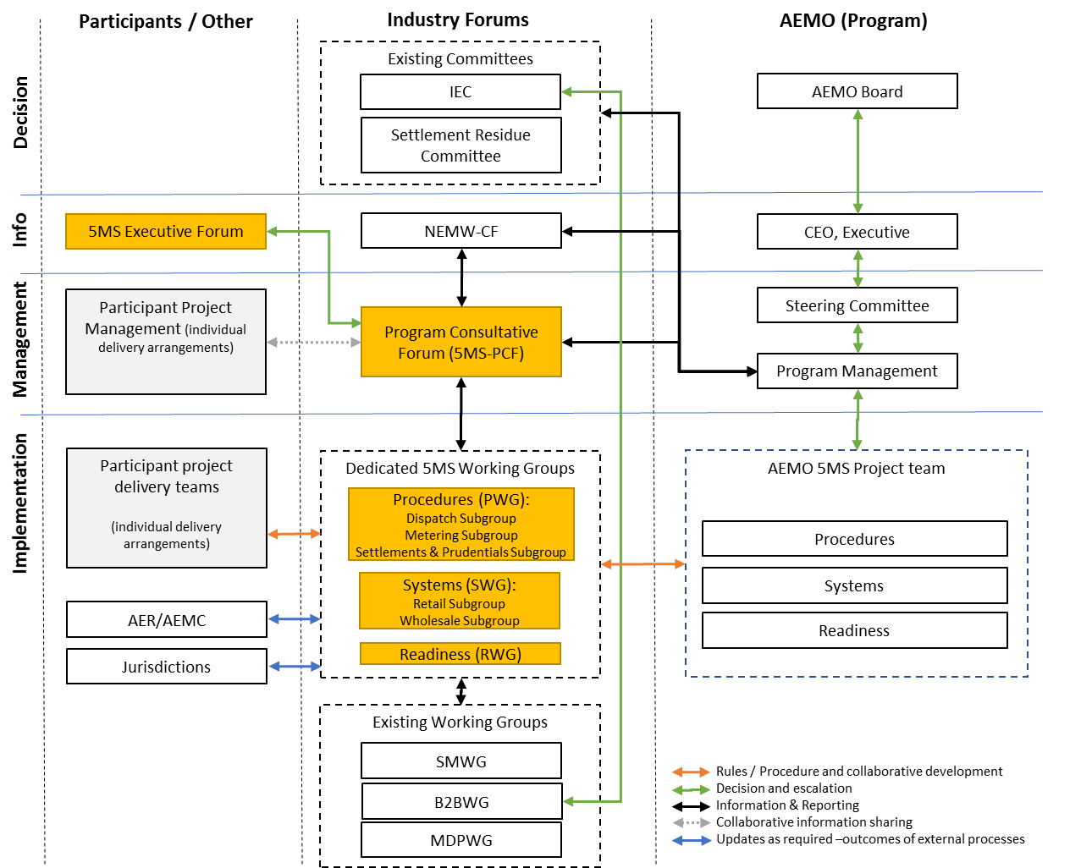
Program engagement structure

Slide 26
Engagement Overview
Engagement method | Purpose
Forums, working groups, and focus groups | Program co-ordination, information-sharing, procedure and system development
One-on-one meetings | In-depth and confidential discussions with participants
Information sessions | General information on the program, open to all
Targeted briefing sessions | Subject-specific briefings
Email updates | Fortnightly information on current events
Website | General program information and repository

Slide 27
Program forums and groups
Group | Purpose | Timing
Program Consultative Forum (5MS-PCF) | The primary program coordination and communication between AEMO and industry program teams (meets monthly) | Monthly, starting July 2018
Executive Forum (5MS-EF) | Provide appropriate level of executive oversight and escalation of issues and concerns (meets quarterly) | Every 2 months, starting July 2018
Procedure Working Group (5MS-PWG) | To facilitate the consultation on procedures, with focus groups for dispatch, metering, and settlements | Monthly, starting August 2018 (focus groups as required)
Systems Working Group (5MS-SWG) | To facilitate design and implementation of systems and interfaces, with focus groups covering retail and wholesale interfaces | Monthly, starting August 2018 (focus groups as required)
Readiness Working Group (5MS-RWG) | Formed in the lead-up to industry readiness testing, to support the planning and execution of readiness activities | Monthly, starting mid-2019

Slide 28
Questions
Chris Muffett

