Slide 1
5MS & GS Program
General Information Session
21 January 2021

Slide 2
Welcome and Introduction
Peter Carruthers

Slide 3
Purpose of the Information Session
The general information session provides an opportunity for stakeholders who:
Are not directly engaged in the 5MS Program to receive an update on the Program’s progress and an insight into the key areas of focus.
Have not previously engaged with the 5MS Program to receive a high-level introduction to the Program.

Slide 4
Agenda
NO | Topic | Description | Speaker
1 | Introduction | A quick reminder of the 5MS and Global Settlements rules An overview of AEMO’s 5MS Engagement Framework
2 | AEMO’s 5MS Program | A look back on the progress made during 2020 The 5MS Program current status including key upcoming milestones
3 | How are market participants impacted by the 5MS and GS rules? | An overview of how participants will be impacted by the AEMO system deployments What actions need to be taken during the transition period between system go-live and rule commencement What must be in place before rule commencement for each participant
4 | Market Trial | An introduction to the purpose of Market Trial and how AEMO will be working with participants to develop the Market Trial plan
5 | Readiness Reporting | An overview of the industry readiness reporting to date discussing trends A look at AEMO’s readiness reporting

Slide 5

The Speakers
AEMO 5MS & GS Program contacts:
  Chair: Peter Carruthers, Business Advocate
  Rowena Leung, Program Director
  Graeme Windley, Senior Project Manager
  Greg Minney, Readiness Manager
  Anne-Marie McCague, Stakeholder Manager

Slide 6

Questions & Feedback
Feel free to ask questions throughout the
session via:
WebEx comments
For more detailed questions, or for any further questions you may have after the session, or to provide engagement feedback, email:
5ms@aemo.com.au
***Please note: this session will be recorded for internal use***

Slide 7
Recap on the 5MS Program
Peter Carruthers & Anne-Marie McCague

Slide 8

5MS Background
WHAT?
WHY?
HOW?
WHEN?
The AEMC announced a final rule to:
Reduce the time interval for financial settlement in the NEM from 30 minutes to five minutes (5MS).
Introduce a ‘global settlement’ framework for settlement of the demand side of the wholesale electricity market. Moving away from the settlement-by-difference approach and the concept of a Local Retailer.
5MS rule change:
The AEMC rule change aligns the market’s price signal with the dispatch of the physical electricity system, which occurs every 5-minutes.
GS rule change:
Global Settlement is an alternative methodology to settlement-by-difference, where unaccounted for energy (UFE) costs are distributed equitably across all retailers.
Refer to the AEMC’s Information sheet for a full list of expected benefits as a result of these rule changes.
AEMO is responsible for implementing the 5MS and GS rules and has established the Five-Minute Settlement (5MS) program to manage this activity.
The 5MS Program is working with industry to ensure these rules are in place and participants are ready, by the rule commencement dates.
Industry engagement and consultation is managed by industry working groups and forums.
The 5MS Program is well under way and on track to progress implementation preparations and system testing ahead of the rule change commencement dates.
However, recently some of the dates for testing have been delayed by ?????:
Rule Commencement Dates:
1 October: Full commencement of 5MS and the soft start of GS
1 May 2022: Full commencement of GS.

Slide 9













5MS Roadmap
Need to update with new dates
GS Market Trials
AEMO is working with industry to implement changes arising from an AEMC Final Determination to implement Five-Minute Settlement (5MS) and Global Settlement (GS) rules.
5MS Market Trials
GS 1-Feb to 15-Mar 2022
9 Mar 2021: MDM system go-live
5MS 5-Jul to 27-Aug 2021
Testing
29-Nov ‘20 to 15-Mar ’21
1-May: GS rule commencement
1 Apr 2020: Reallocations go-live
1-Oct: 5MS rule commencement
6-Dec 2018: AEMC made GS rule
1 Apr 2021: 5-minute Bidding
19 Apr: Settlement solution go-live
3-month deferral
May 2022
Mar 2022
Industry Working Groups established
9 Jul 2020: AEMC delayed both 5MS & GS rule by 3 months
Oct 2021
Aug 2021
8-Aug 2019: AEMC Amended the 5MS & GS rules to improve and clarify
Apr 2021
5MS Program established
Mar 2021
Jul 2020
Apr 2020
28 Nov 2017: AEMC made 5MS rule
Aug 2019
Dec 2018
Reference Key
July 2018
Early 2018
Icon | Decision-maker
 | Regulatory
 | AEMO/ 5MS Program
Nov 2017
9

Slide 10
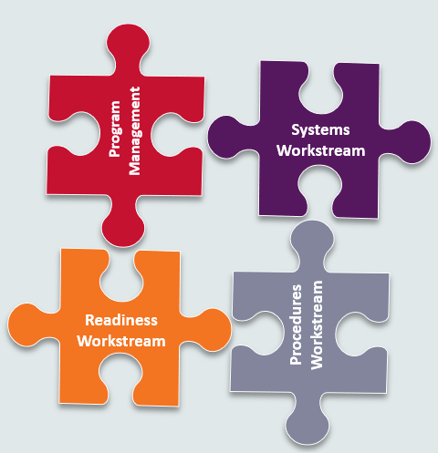

The 5MS Working Groups are AEMO’s framework to facilitate two-way communication with Industry
5MS Program
Who’s impacted:
  Generators
  Retailers
  Metering Providers (MP)
  Meter Data Providers (MDP)
  Metering Coordinators (MC)
  Distribution Network Service Providers (DNSP)
  Transmission Network Service Providers (TNSP)
5MS Working Groups

Slide 11
Industry Engagement framework
Engagement between AEMO and industry is crucial to the 5MS Program’s success, which is why each 5MS workstream has been aligned to an industry working group.
Executive
Forum (EF)
Program Consultative Forum (PCF)
Systems
Working Group (SWG)
Readiness
Working Group (RWG)
Procedures
Working Group (PWG)
Industry Testing
Working Group (ITWG)
EF: an information and discussion forum for executive-level representatives of interested organisations
PCF: provides review of relevant documentation and management oversight for 5MS working groups.
Now closed
Merged
RWG: coordinates readiness activities across the industry, particularly with respect to market testing and trials
SWG: seeks input from industry on system design and interface changes to support 5MS and GS implementation.
PWG: a forum to engage with industry stakeholders during the procedure development process.
ITWG: provides a forum for AEMO and industry stakeholders to engage in detail on testing matters related to the 5MS & GS implementation program.

Slide 12
AEMO 5MS Program Update
Rowena Leung and Graeme Windley

Slide 13
5MS Program timeline
5MS Program Timeline – Level 1 Milestones
Key call outs:
Overall Program is Green
Intense time for testing & development activity across all workstreams, particularly metering
Next key milestone 31/8
Staging release for Retail planned for 31/8

Slide 14


Six months looking back
The 5MS Program achieved some significant milestones during the year, including the first system go-live on 1 April with the Reallocations solution.
This solution provides the capability to receive reallocations at five-minute intervals in preparation for commencement of the 5MS rule.
31-Jan: Settlements Package 1 in Staging
15-May: Settlements Package 3 in Staging
26-Feb: Reallocations I Pre-Production
15-May: Dispatch Package 2 in Staging
16-Mar: Settlements Package 2 in Staging
15-Jun: Staging Retail Release 2
1-Apr: Reallocations Go-Live
Jan-Jun 2020
Jan | Feb | Mar | Apr | May | Jun
7-Feb: Final Metering Transition Plan
Reference Key
 | Readiness activity
 | System activity
 | System go-live
18-Feb: Final MSP Accreditation Update Plan
7-May: Readiness Reporting Round 2 Results
28-Feb- Readiness Reporting Round 1 Results

Slide 15

A forward view: 2020-2021
31-Aug: AEMO Internal Development complete
1-Apr: 5-min Bidding Phased Go-Live begins
1 Apr: Settlement Platform Go-Live
31-Aug: Staging Retail Release 3
9-Mar: AEMO Metering Solution Go-Live
1-Oct:Commencement of 5MS
1-Oct Soft start of GS
Jul-Dec 2020
Jan-Dec 2021
Jul | Aug | Sep | Oct | Nov | Dec
Jan | Feb | Mar | Apr | May | Jun | Jul | Aug | Sep | Oct | Nov | Dec
9-Jul: AEMC announces deferral decision
Dispatch Testing
29-Nov: Dispatch Industry Test starts & 15 Mar concludes
10-Dec: Readiness Reporting Round 5 Results
5MS
Market Trial
24-Jul: Special Readiness Survey Results
20-Nov: Final Industry Go-Live Plan – Retail MDM
Settlem’ts
Testing
MDM/B2M
5-Jul:5MS Market Trial starts
27-Aug:5MS Market Trial concludes
Reference Key
 | Readiness activity
 | System activity
 | System go-live
 | Rule commencement
28-Aug: Final Industry Transition Plan – Bidding
29-Oct: Readiness Reporting Round 4 Results
17-Feb: Settlements Industry Test starts & 15-Mar: concludes
3-Sep: Readiness Reporting Round 3 Results
1-Feb Retail MDM/B2M starts & 3-Mar: concludes
Readiness reporting
Dates TBA

Slide 16

A forward view: 2022
1-May: Commencement of financial settlement of GS
1-Dec: Compliance date
for all new and replacement metering installations
1-Jun: AEMO required to publish UFE report on unaccounted for energy trends
Jan-Dec 2022
Jan | Feb | Mar | Apr | May | Jun | Jul | Aug | Sep | Oct | Nov | Dec
GS
Market Trial
1-Feb:5MS
Market Trial
starts
15-Mar:5MS Market Trial Concludes
Reference Key
 | Readiness activity
 | Compliance activity
 | Rule commencement

Slide 17
How are market participants impacted by the 5MS and GS rules?

Slide 18
An overview of how participants will be impacted by the AEMO system deployments
What actions need to be taken during the transition period between system go-live and rule commencement
  Bidding transition plan
  Settlements
  MTP, rollout plan, how is this being monitored and why
What must be in place before rule commencement for each participant – critical Capabilty and how it is monitored

Slide 19
What is changing? -
Restuture to include participant view and timing?
5MS
Bids/offers will be submitted in 5-min granularity
Meters will need to read and send 5-min data
GS
Unaccounted for energy (UFE) will be allocated to all Retailers in a market area on a pro-rata basis
Cross-boundary meters
5-min data will need to be submitted for each NMI
Settlement will be on a 5-min basis
Reallocations need to be on a 5-min basis
MDM MDFF
JSON
Non-contestable unmetered load NMIs
All type 1,2,3 meters by 01-Oct-21
Transmission connected Type 4 by 01-Oct-21
xxxx

Slide 20
Impact by Participant Type
Summarise and include timing - especially in relation to GS- Soft start
Learn more here
 | 5MS Rule | GS Rule
Generator | Submit 5-minute bids Manage 5-minute reallocations, if applicable Manage 5-minute metering data Manage new NMI Classification Codes
Retailer | Manage 5-minute metering data Manage 5-minute reallocations, if applicable Receive and process new NMI classification codes | Reconcile market settlement invoices, including unaccounted for energy (UFE) Manage non-contestable unmetered loads (local retailers only)
Distribution Network Service Provider | Develop capability to receive 5-minute metering data | Determine and engage Metering Coordinators (MCs) (after Global Settlement market commencement on 1 May 2022) Develop agreements with contestable MCs to install cross-boundary meters before 1 May 2022 Create and maintain cross-boundary NMIs in MSATS Develop capability to manage and apply new NMI classification codes Create and maintain non-contestable unmetered load NMIs, inventory tables and calculation methodologies
Transmission Network Service Provider
Perhaps tidy up and include our path to market commencement as visual?

Slide 21
Summarise and include timing - especially in relation to GS- Soft start
 | 5MS | GS
Metering Coordinator | Engage with financially responsible market participants (FRMPs) and metering providers on the configuration and/or replacement of certain meters to enable 5-minute granularity. Facilitate the installation of new and replacement 5-minute capable type 4 meters installed from December 2018 (or December 2019 in the case of type 4A meters). | Assist with the resolution of any connection point or metering issues identified as part of UFE reporting, particularly cross-boundary metering.
Metering Provider | Where necessary, update accreditation Where necessary, Submit application to AEMO for metering installation data storage exemptions As arranged by MCs, install, replace or reconfigure meters to 5-minute trading intervals as required. Create or update MSATS NMI standing data as required. | Assist with the resolution of any connection point or metering issues identified as part of Unaccounted for Energy (UFE) publication.
Metering data provider | Where necessary, update accreditation Retrieve, store and deliver 5-minute metering data to Participants and AEMO Create or update MSATS datastream standing data as required. | Assist with the resolution of any connection point or metering issues identified as part of Unaccounted for Energy (UFE) publication

Slide 22
Some criteria is more important than others
Working with the RWG, AEMO has identified “critical capability” for each participant type
Should this be more part of readiness reporting – ie how will we know the industry is ready

Slide 23
Market Trial

Slide 24
Participant Testing – what testing opportunities are there for particants
Talk a bit about our own internal testing (why – apart from when made available in pre-prod AEMO will have already performed its UAT etc)
Testing Strategy
Staging – initial testing of interfaces
Pre-prod (this is an environment where industry testing and market trials are performed)
Industry testing – B2B testing
Invitation testing
Market Trial
  Purpose
  Is it mandatory?
  When is it
  How is it being developed?
  Do we know anything about the scenarios yet?
  How do participants get involved?

Slide 25
AEMO 5MS Testing Environments
5MS Staging Environment
  Provide software to enable early testing of functionality by participants
  Environment is not fully integrated across all applications
  Will be extended to support testing as part of deferred rule commencement dates
AEMO pre-production environment (pre-prod)
  Used for all market trials and formal industry testing
  Reflects production capability – and capability to be released during market trial and industry test period

Slide 26
Participant Testing Types
Type | Definition | Environment | Example
Industry Testing | Self-testing of functionality such as connectivity, and/or coordinated multiparty testing of functional scenarios | Staging, pre-prod | Testing a change request (CR) or processing a reallocation
Market Trial | AEMO coordinated multi-party end-to-end testing of business process scenarios | Pre-prod | Meter exchange involving CRs, services orders and 5-minute meter reads
Invitation Industry Testing | AEMO coordinated testing of business process scenarios with a select number or subset of participants with systems ready for testing. | Pre-prod | Testing NMI transfer Process
Approach to participant testing was developed in consultation with industry and is captured in the Industry Test and Market Trial Strategy

Slide 27
5MS Program Timeline
Level 1 & Level 2 Milestones relating to Readiness and Participant Testing
29-Nov: Dispatch Industry Test starts
15-Mar: Dispatch Industry Test concludes
Dispatch Testing
Update with new dates – and include Staging opportunities
17-Feb: Settlements Industry Test starts & 15-Mar: concludes
Industry Testing
Settlem’ts
Testing
1-Feb Retail MDM/B2M starts & 3-Mar: concludes
2020
2021
MDM/B2M
2022
Nov | Dec
Jan | Feb | Mar | Apr | May | Jun | Jul | Aug | Sep | Oct | Nov | Dec
Jan | Feb | Mar | Apr
GS
Market Trial
5MS Market Trial Plan
Sept20: 5MS Market Trial Plan through to May21
5MS
Market Trial
1-Feb:5MS
Market Trial
starts
15-Mar:5MS Market Trial Concludes
5-Jul:5MS Market Trial starts
27-Aug:5MS Market Trial concludes
Market Trials
GS Market Trial Plan
Reference Key
 | Readiness activity
Sep21: GS Market Trial Plan Sep through to Dec 21

Slide 28
Industry Readiness – how is the industry progressing?
Greg Minney

Slide 29


Readiness approach
AEMO's Readiness Workstream is responsible for activities in preparation for transition to and commencement of the 5-Minute Settlements and Global Settlement rules. Activities include:
Industry readiness reporting
Industry testing & Market trials
Market Readiness Strategy
Market trial/ Industry test plans
Industry transition & Go-live
Transition plans
Cut-over plans
Industry contingency
Metering service provider accreditation update

Slide 30
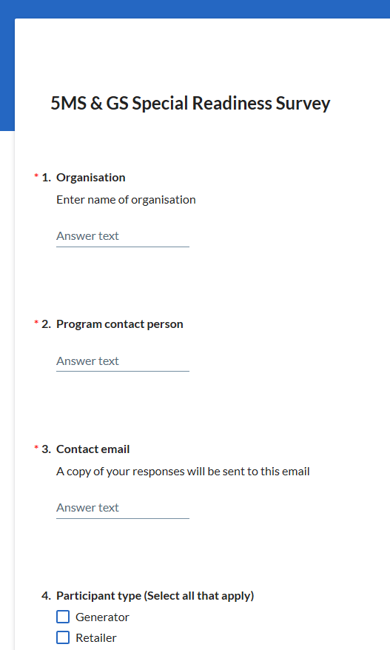

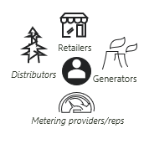


Readiness reporting approach
Readiness reporting is voluntary
We encourage open and honest self-assessment
Responses are confidential (although we do publish a list of respondents)
Results are aggregated to produce a report
Results are discussed with our RWG and together we identify any actions that need to be taken
Online Participant survey
Full Report
Discuss results at working groups
Targeted action
Notes:
Objective:
To facilitate readiness reporting throughout the implementation phase of 5MS and GS so that AEMO, NEM participants and other interested stakeholders have an accurate assessment of industry’s readiness for the various 5MS and GS market system “go-lives”, transitional activities and commencements.
Key Principles:
Industry participation in the readiness reporting process is voluntary but strongly encouraged and in the interest of all participants.
Participants are responsible for establishing their own appropriate project schedule baselines and reporting their status against these.
Participants will submit open and honest self-assessments of their readiness status, following a framework and format set out in the Industry readiness reporting plan.
Readiness reporting information will be collated and submitted by an authorised person on behalf of their organisation.
AEMO will develop and seek input from the RWG on readiness reporting criteria.
Readiness reporting will be on a regular basis, following a defined calendar developed in collaboration with the RWG. In developing the reporting calendar, the effort of reporting will be balanced with the value of reporting.
As far as practicable, changes to the readiness survey questionnaire will only occur where further detail is required on key criteria.
AEMO will aggregate survey responses and prepare a Market Readiness Report following the approach defined in the readiness reporting plan
All responses will be treated as strictly confidential in-line with AEMO policies. The results from any analysis will be reported in aggregate and no individual organisations will be identified or identifiable.

Slide 31
Reporting Criteria
General Readiness Criteria
Specific Readiness Criteria
Metering Transition Plan monitoring
Program establishment and progress
Overall governance
Common to all participants
Implementation of capability for 5MS/GS
Specific to participant type, including AEMO
Required for the successful operation of the market in 5MS/GS scenario
Monitors the status of metering transition activities defined in the Metering transition plan

Slide 32
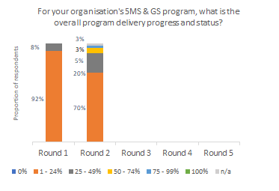
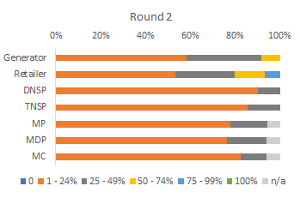
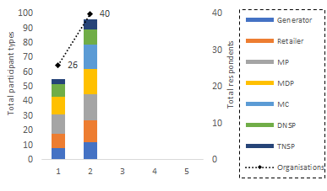
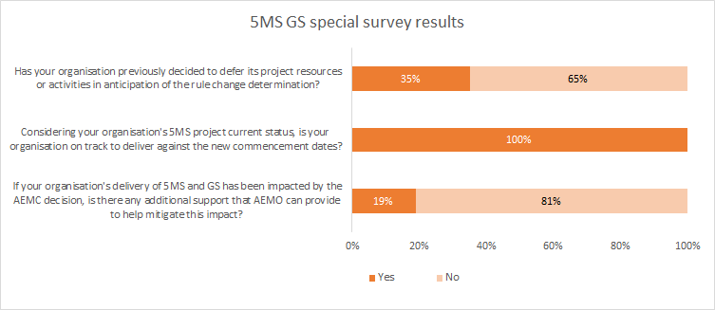
Summary of results so far
Overall Participant Delivery progress
Overall Delivery progress by Participant type
Overall Participation by Participant type
Industry Deferral Survey Participant impact summary

Slide 33
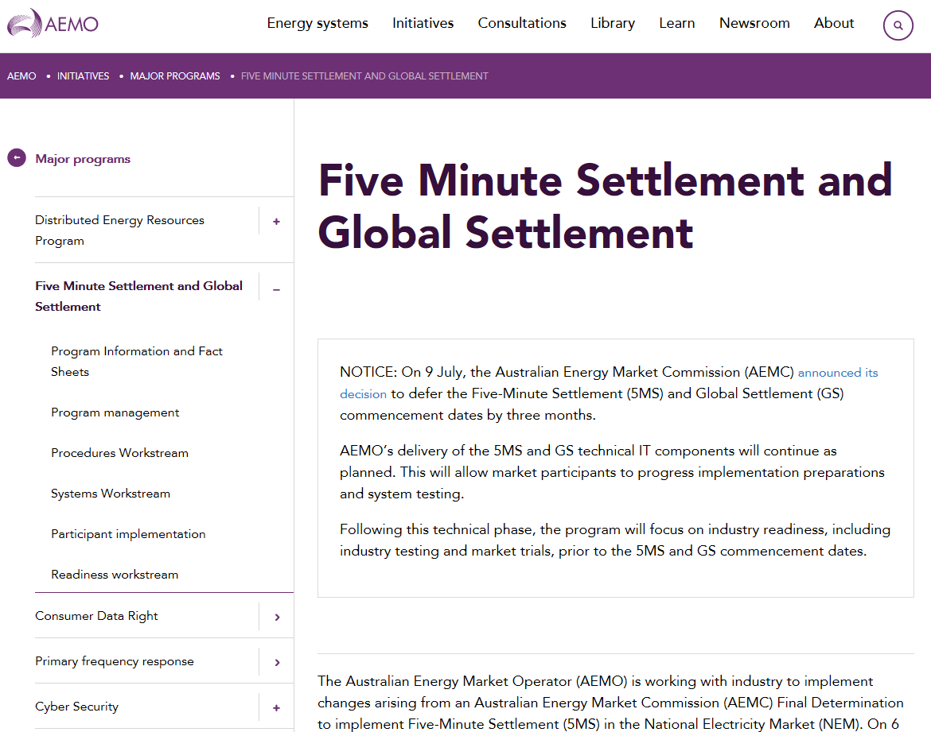


How can I learn more?
Key links:
5MS Rule
GS Rule
Rule Amendment
Deferral Decision
This website will be getting a make-over in February.
AEMO’s 5MS Program website
AEMC’s website
Contact the 5MS team at:
5ms@aemo.com.au

Slide 34
Questions?

