Slide 1
5MS & GS Transition Focus Group #19
Thursday, 9 Sept 2021
This meeting is recorded for the purpose of minute taking.
Please disconnect from your workplace VPN for the WebEx call

Slide 2
AEMO Competition Law Meeting Protocol
AEMO is committed to complying with all applicable laws, including the Competition and Consumer Act 2010 (CCA). In any dealings with AEMO regarding proposed reforms or other initiatives, all participants agree to adhere to the CCA at all times and to comply with this Protocol. Participants must arrange for their representatives to be briefed on competition law risks and obligations.
Participants in AEMO discussions must:
Ensure that discussions are limited to the matters contemplated by the agenda for the discussion
Make independent and unilateral decisions about their commercial positions and approach in relation to the matters under discussion with AEMO
Immediately and clearly raise an objection with AEMO or the Chair of the meeting if a matter is discussed that the participant is concerned may give rise to competition law risks or a breach of this Protocol
Participants in AEMO meetings must not discuss or agree on the following topics:
Which customers they will supply or market to
The price or other terms at which Participants will supply
Bids or tenders, including the nature of a bid that a Participant intends to make or whether the Participant will participate in the bid
Which suppliers Participants will acquire from (or the price or other terms on which they acquire goods or services)
Refusing to supply a person or company access to any products, services or inputs they require
Under no circumstances must Participants share Competitively Sensitive Information. Competitively Sensitive Information means confidential information relating to a Participant which if disclosed to a competitor could affect its current or future commercial strategies, such as pricing information, customer terms and conditions, supply terms and conditions, sales, marketing or procurement strategies, product development, margins, costs, capacity or production planning.

Slide 3
Welcome
Greg Minney

Slide 4
Agenda
NO | Indicative Time | AGENDA ITEM | Responsible
1 | 10:30 - 10:40 | Welcome and Introduction | Greg Minney
2 |  | 5MS Start Notice Update | Greg Minney
3 |  | Tranche 1 Metering Update | Blaine Miner
4 |  | August Rollout Plan Overview | Blaine Miner
5 |  | CATS Transaction Analysis Update | Paul Lyttle
6 |  | MTP Update | Blaine Miner
7 |  | Next Steps and General Business | Greg Minney

Slide 5
Attendee | Organisation | Attendee | Organisation | Attendee | Organisation | Attendee | Organisation
Greg Minney | AEMO | Vicki Grant | Clean Co Qld | Jeff Colby | Mondo | Joanna Ford | TasNetworks
Blaine Miner | AEMO | Ramesh Khadka | ElectraNet | Neville Lewis | Mondo | Adam Hoare | Transgrid
Anne-Marie McCague | AEMO | Dino Ou | Endeavour Energy | Mario Iogha | Origin | Paul Greenwood | Vectorams
David Ripper | AEMO | Nicole Bright | Energex | Linda Brackenbury | PlusES | dgoswami
Jim Agelopoulos | AEMO | Cindy Matthews | Energy Queensland | Greg Szot | Powercor
Lucas Senteleky | AEMO | Steve Blair | Energy Queensland | Mark Pilkington | Powercor
Tui Grant | AEMO | Ingrid Farah | Ergon | Dean Knight | Powerlink
Paul Lyttle | AEMO | Andrew Jumeau | Evo Energy | Karel Mallinson | Powerlink
Peta Hatzikides | AEMO | Jeff Roberts | Evo Energy | Christophe Bechia | Red Energy
Simon Tu | AEMO | Greg Evans | Evergen | Mark Reid | Red Energy
Collette Reedy | Actewagl | Anthony Croce | Infigen Energy | Manjari Saji | Red Energy
Sue Richardson | Agility CS | Victor Sanchez | Infigen Energy | Nick Gustafsson | Red Energy
Pieter Wijtzes | AGL | Pieter Wijtzes | Intellihub | David Woods | SA Power
Zulfi Syed | Alinta Energy | Warren Van Wyk | Intellihub | Andrew Wilkins | SA Water
Craig Eadie | Aurora Energy | Leon Vilfand | Jemena | Audrey Follett | Snowy Hydro
Wayne Turner | Ausgrid | Joe Lyttleton | Jemena | Sandra Ho | Snowy Hydro
Con Michailides | Ausnet | Matthew Mullen | Jemena | Elizabeth Keogh | Stanwell
Greg Mather | Basslink | Rajiv Balasubramanian | Jemena | Rossi Mangano | Stanwell

Slide 6
5MS Start Notice
Greg Minney

Slide 7
5MS start notice process
13-Aug
Readiness Questionnaire Round 9 Due
19-Aug PCF
Update on progress against essential criteria
24-Aug
Target for completing critical 5-min Market Trial scenarios
26-Aug PCF
Readiness Report Round 9 published
PCF Briefing
30-Aug
AEMO present go/no-go to Executive Forum
01-Sep
5MS start notice submitted by AEMO to AEMC
TBD-Sep
AEMC Final Determination
Two key risks were identified with the PCF on 26-Aug:
1. Low level of test execution by participants through Market Trial may indicate risk to industry readiness
2. AEMO’s RM report distribution timing and accuracy and issues with daily estimate files
AEMO recommended proceeding with 1 October 2021 to Executive Forum on 30-Aug noting:
There are no showstoppers for any essential capability category and a risk management plan to mange outstanding risk.
Offers a superior option to either delay option
Risk management:
Defect fixes for Market Trial identified and scheduled
Market Trial extended by 2 weeks to demonstrate smooth settlement runs and increase opportunity for participant testing
5MS start notice
Circulated to those on the 5MS general information distribution list
Published on 5MS webpage

Slide 8
Meeting Notes
No questions

Slide 9
Tranche 1 Metering Update
Blaine Miner

Slide 10
Tranche 1 Meters Overview (As at 6 September 2021)
Total Tranche 1 meters – 19,381
Essential Meters (Transmission connected)
Number and classification of essential meters has changed due to recent Participant standing data updates in MSATS
Total number of meters – 4,332
4,237 meters are currently being reported as being 5min capable, after MP updates are applied
Of the remaining 95 meters:
26 ‘Active’ meters are still not 5min capable, after MP updates are applied
Majority of outstanding essential meters scheduled to become 5min capable by the end of next week (17 Sept)
69 ‘Non-active’ meters (Greenfield, De-energised, Non-market, etc.) are being treated as low risk
Non-essential Meters (Distribution Connected)
Total number of meters - 15,049
13,548 meters are currently being reported as being 5min capable
Of the remaining 1,501 meters:
1,390 meters are still not 5min capable
111 ‘Non-active’ meters (Greenfield, De-energised, Non-market, etc.) are being treated as low risk
Notes:
MP and MDP Contingency Plans relating to essential metering capability (installation and delivery of 5min metering data) are currently being established/finalised with applicable Participants
MSPs are being encouraged to engage effected Participants as early as possible
NMI Classification Code updates are progressing but a material number of updates are still to be completed

Slide 11
Tranche 1 Overview (Post MP Update – as at 6 Sept)
Category | NMI Class | # of meters | 5min Capable | Scheduled for Sept | Greenfield/ De-energised, Non-market
Essential | Bulk | 2,463 | 2,441 | 15 | 7
 | Interconnector | 9 | 9
 | Market Generators | 803 | 792 | 1 | 10
 | NREG | 983 | 922 | 10 | 51
 | Market Customers | 39 | 39
 | Cross Boundary | 34 | 33 |  | 1
 | Small | 1 | 1
 | Essential Totals | 4,332 | 4,237 | 26 | 69
Non-essential | Large | 14,680 | 13,259 | 1,342 | 79
 | Small | 354 | 274 | 48 | 32
 | Market Customer | 15 | 15
 | Non-essential Totals | 15,049 | 13,548 | 1,390 | 111
 | Tranche 1 Grand Total | 19,381 | 17,785 | 1,416 | 180

Slide 12
Tranche 1 Overview (Based on MSATS RTCs Only – as at 8 Sept)
Category | NMI Class | # of meters | With 5min RTC | % with 5min RTC | RTC still to be updated
Essential | Bulk | 2,465 | 2,316 |  | 149
 | Interconnector | 9 | 6 |  | 3
 | Market Generators | 803 | 713 |  | 90
 | NREG | 982 | 943 |  | 39
 | Market Customers | 39 | 39
 | Cross Boundary | 35 | 33 |  | 2
 | Small | 1 | 1
 | Essential Totals | 4,334 | 4,051 | 93.47% | 283
Non-essential | Large | 14,679 | 13,311 |  | 1,368
 | Small | 352 | 296 |  | 56
 | Market Customer | 15 | 15
 | Non-essential Totals | 15,046 | 13,622 | 90.54% | 1,424
 | Tranche 1 Grand Total | 19,380 | 17,673 | 91.19% | 1,707

Slide 13
Meeting Notes
AEMO confirmed that:
AEMO is in continual contact with MPs, through weekly updates, to confirm how they are tracking with the conversion of Tranche 1 meters to 5min by 1 October 2021
AEMO is engaging with appliable MPs and MDPs to ensure contingency plans are in place, where:
An essential meter is at risk of not being 5min capable by 1 Oct 2021
An MDP has not proven their 5min MDFF metering data delivery capability by 31 Aug 2021
NMI Classification Code updates are progressing but a material number of updates are still to be completed, primarily associated with SGAs and Bulk Supply Points
If the NMI Classification updates are not fully completed by 1 October, this would not impact the accuracy of market settlements but may impact UFE reporting classifications.
An MSP would be in breach of the NER should:
A Tranche 1 metering installation they service not be 5min capable by 1 October 2021
An MDP not be delivering 5min metering data for a Tranche 1 meter by 1 October 2021
AEMO noted:
That Participants can contact AEMO to see if they potentially have any exposure to Tranche 1 meters not being 5min capable by 1 October 2021
AEMO will only be able to provide such information where they are a current role to the NMI

Slide 14
Meeting Notes
AEMO confirmed that for ‘non-essential’ tranche 1 meters, which are not 5 minute capable by 1 October 2021, that:
The MP would be in breach of the NER
Should an MDP subsequently deliver 15 or 30mins reads associated to that meter, that they would be in breach of the NER and to self report the issue
Whilst the MDP may be in breach, AEMO will be able to profile the delivered 15 or 30 minute read, by applying the applicable 5min Load Profile, in order to settle the market

Slide 15
August Rollout Plan Overview
Blaine Miner

Slide 16
Rollout Plan Responses
Organisation | MC/MP Tranche 1 | MDP Tranche 1 | MDP Tranche 2 | MP RTC Tranche 2 | MDP Net to Reg T1 and T2 | LNSP NCONUML and Cross Boundary | Explicit Consent Provided
AusNet Services |  |  | Yes | Yes | Yes | Yes | Yes
AusNet Transmission | Yes |  |  |  |  |  | No
Ausgrid | Yes |  |  |  |  | Yes | Yes
Citipower/ Powercor | Yes |  | Yes | Yes | Yes | Yes | Yes
ElectraNet | Yes |  |  |  |  |  | Yes
Endeavour Energy |  |  |  |  | Yes | Yes | Yes
Energex |  |  | Yes | Yes | Yes | Yes | Yes
Ergon |  |  | Yes | Yes | Yes | Yes | Yes
EvoEnergy | Yes |  |  |  | Yes | Yes | Yes
Intellihub | Yes | Yes | Yes | Yes | Yes |  | No
Jemena |  |  | Yes | Yes | Yes | Yes | Yes
Mondo | Yes | Yes | Yes |  |  |  | No
Organisation | MC/MP Tranche 1 | MDP Tranche 1 | MDP Tranche 2 | MP RTC T2 | MDP Net to Reg T1 and T2 | LNSP NCONUML and Cross Boundary | Explicit Consent Provided
Origin | Yes |  |  |  |  |  | No
PlusES | Yes | Yes | Yes | Yes | Yes |  | Yes
Powerlink | Yes |  |  |  |  |  | Yes
Powermetric | Yes | Yes | Yes | Yes | Yes |  | No
SAPN |  |  |  |  | Yes | Yes | Yes
TasNetworks (DNSP) |  |  |  |  | Yes | Yes | Yes
TasNetworks (TNSP) | Yes |  |  |  |  |  | Yes
TransGrid | Yes |  |  |  |  |  | Yes
United Energy | Yes |  | Yes | Yes | Yes | Yes | Yes
Vector |  |  | Yes | Yes | Yes |  | No
Yurika | Yes | Yes | Yes | Yes | Yes |  | Yes
23 organisations provided AEMO with rollout plan updates, 2 less than last round (17 Plans were subsequently distributed 25 August)
Last rollout plan update to be requested by AEMO?

Slide 17
Meeting Notes
No questions

Slide 18
CATS Transaction Analysis Update
Paul Lyttle

Slide 19
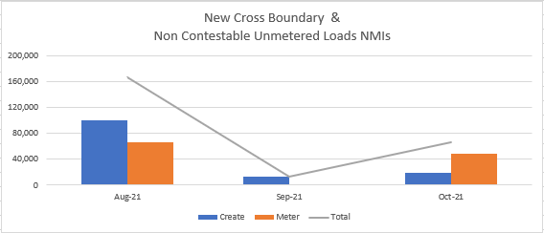
NCONUML & Cross Boundary Summary
The majority of unmetered supplies were scheduled to be set up in August
There is a reported 28,000 NCONUMLs that will not be activated by 1 Oct 2021 (GS Soft Start)
There is a reported 37 Cross Boundary connection points that will not be activated by 1 Oct 2021 (GS Soft Start)

Slide 20
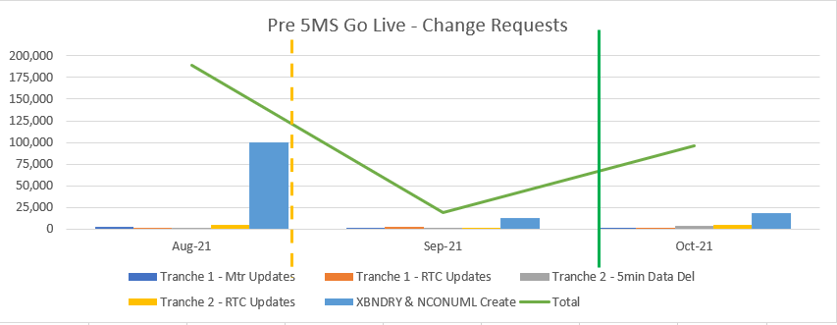
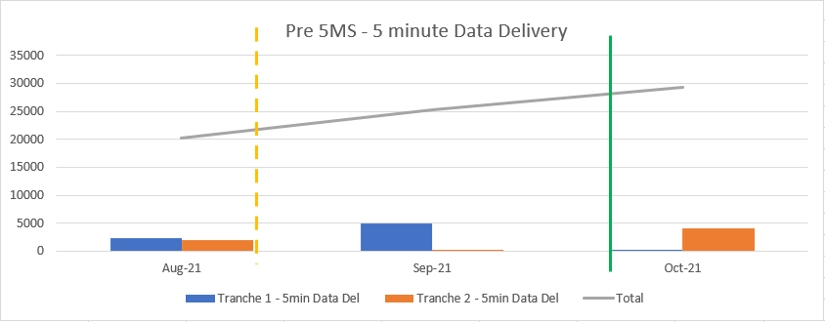
Pre-5MS Commencement Transaction Summary
Consolidated Tranche 1 & 2 change requests
Peak update was scheduled for August 2021 with an estimated 189,000 CRs to be raised
The majority of the August CRs related to activating NCONUML
Consolidated Tranche 1 & 2 5min metering data delivery
A total of 18,226 Tranche 1 meters estimated to be providing 5min reads by end of September 2021

Slide 21
Tranche 2 – Consolidated Plan Results
Material CR volumes expected to occur from November 2021
Peak month is currently expected to be December 2021, with ~333,000 CRs expected to be initiated
No material change from July plans
Material CR volumes expected to occur from December 2021
Peak months are currently expected to be April & July 2022, with ~315,000 CRs expected to be initiated
No material change from July plans

Slide 22
Post 5MS Consolidated Plan Summary
Estimated Peak to be in April 2022 with ~631,800 CRs expected to be initiated
Numbers include:
RTC updates
Net to Register datastream conversions
No material change from July plans
A total of ~2,725,000 meters estimated to be providing 5min reads by December 2022
No material change from July plans

Slide 23
Meeting Notes
No questions

Slide 24
MTP Update
Blaine Miner

Slide 25
Activities Now Deemed Completed
Description | Date | Activity ID
MCs, for any registered ‘Special Site’, update and distribute algorithms adjusted for introduction of 5min interval length to AEMO, FRMP and LNSP for approval. | By 31 August 2021 | A31
MDPs to create/activate export and import datastreams in CNDS table (reminder of 1 Oct Net to Register obligations) | By 31 August 2021 | A36, A40, A45, A51
MPs to complete data cleanse to ensure, the RegisterID matches the content of the ‘Suffix’ within the CATS_REGISTER_IDENTIFIER table | By 31 August 2021 | A36a, A40a, A45a
MDPs to update Type 7 datastreams in MSATS | By 31 August 2021 | A83
DNSPs and AEMO - Cross boundary supplies: create cross boundary NMIs, datastreams and registers; DNSPs to provide cross boundary information to AEMO; AEMO to provide TNI2 values; DNSPs to update TNI fields with TNI2 values | By 31 August 2021 | A95, A96, A97, A95b, A97a, A97b
DNSPs, MDPs and MPs - Create NCONUML NMIs, datastreams and registers | By 31 August 2021 | A99, A100, A101
DNSPs and AEMO - Update NMIs with new NMI Classification codes as required | By 31 August 2021 | A103, A105, A107, A109, A111, A113, A115
MDPs to ensure all Sample meters have a Datastream type code of 'P' and are attached to a Profile | By 31 August 2021 | A119
MDPs to update VIC TUoS Datastream type codes from 1-4 to 'I' or 'N' as required | By 31 August 2021 | A120
5min metering data delivered to AEMO (MDFF) | By 31 August 2021 | A35, A41, A46, A50

Slide 26
Upcoming MTP Transition End Dates
Description | Date | Activity ID
Determine and engage Metering Coordinator (after Global Settlement market commencement on 1 May 2022) | By 30 September 2021 | A17
Install or reconfigure ‘unknown’ cross boundary meters as required | By 30 September 2021 | A24
AEMO to provide 5-minute SCADA data | By 30 September 2021 | A30
Delivery of Type 7 5min metering data | By 30 September 2021 | A82, A86
Delivery of NCONUML 5min metering data | By 30 September 2021 | A90, A92
Delivery of all interval metering to AEMO via MDFF | By 30 September 2021 | A94
MSP (1 Oct 2021 related) Accreditation approvals | By 30 September 2021 | A126, A134

Slide 27
Meeting Notes
No questions

Slide 28
Next steps and General Business
Greg Minney

Slide 29
Next steps and General Business
The updated version of the Cross Boundary Supply Guideline has now been published to AEMO’s website
The changes to the Guideline are related to the introduction of requirements for metered emergency connections
Participants may provide comments on the Cross Boundary Supply Guideline v1.1 Draft by 8 October 2021
https://www.aemo.com.au/initiatives/major-programs/nem-five-minute-settlement-program-and-global-settlement/industry-working-groups-and-readiness/industry-readiness-strategy
Questions:
Do you believe the TFG still has a role to play post 1 October 2021?
What type, and frequency, of engagement do you believe will be required to support post 1 Oct 2021 MTP activities?
E.g. Tranche 2 metering transition and the conversion of LR and FRMP to GLOPOOL
R U OK? day is today – take care of yourselves and each other
All the very best for 1 October and thank you for all of your support over the last 2yrs

Slide 30
Meeting Notes
Comments provided from participants in relation to the TFG’s role post 1 October:
Consolidate the TFG into RWG or both into PCF and make it a broader 5MS forum
Would prefer for Rollout plan updates to still occur every 2 months, to inform business CR volume considerations
More focus on Settlements/Reconciliation post go-live
Need a channel to still have conversations about the ‘GLOPOOL’ updates on 1 Mat 2022
Any additional feedback can be sent to 5MS@aemo.com.au

Slide 31
Thank you for your attendance, participation and ongoing support!

