Slide 1
5MS Dispatch Focus Group
Tuesday 27th November
AEMO Office, LEVEL 22, 530 COLLINS STREET, MELBOURNE

Slide 2
Agenda
NO | Time | AGENDA ITEM | Responsible
Preliminary Matters
1 | 10:00am – 10:10am | Welcome, introduction and apologies | Michael Sanders (AEMO)
Matters for Discussion
2 | 10:10am – 10:40am | Notes and actions from previous meeting | Michael Sanders, Hamish McNeish, Emily Brodie (AEMO)
3 | 10:40am – 11:00am | REBIDEXPLANATION field | Michael Sanders (AEMO)
4 | 11:00am – 12:00pm | Bidding web user interface | Pierre Fromager (AEMO)
 | 12:00pm – 12:45pm | LUNCH
5 | 12:45pm – 1:30pm | Bidding APIs | Hamish McNeish (AEMO)
Other Business
6 | 1:30pm – 2:00pm | General questions and next steps | Michael Sanders & Hamish McNeish (AEMO)

Slide 3
Notes and actions from previous meeting
Hamish McNeish (AEMO)

Slide 4
Actions from previous meeting (1)
22 October 2018, Brisbane
Item | Action | Responsible | Due date | Response
2 | AEMO to set focus group meeting and agenda, and communicate to participants. | AEMO | 31 October 2018 | Complete
3 | AEMO to investigate and communicate how long it takes to publish data | AEMO | 14 December 2018 | Under investigation
3 | AEMO to investigate inclusion of fast-start inflexibility profiles in P5, potentially as part of the drafting amendments rule change request (targeted for January 2019). | AEMO | 30 November 2018 | AEMO will submit a “5MS implementation amendments” rule change request to the AEMC in early 2019. It will include a proposal to remove the prohibition on using FSIPs in pre-dispatch.
5a | AEMO to consult on software release approach. | AEMO | November 2018 | This will discussed in a subsequent SWG.
5a | AEMO to monitor participant bidding as part of readiness for 5MS | AEMO | November 2020 | Ongoing
5a | AEMO will provide the API Swagger files. | AEMO | TBC | These will be provided once API’s are available in the Sandbox environment.

Slide 5
Actions from previous meeting (2)
22 October 2018, Brisbane
Item | Action | Responsible | Due date | Response
5b | AEMO to provide API specifications in line with SWG schedule. | AEMO | March 2019 | The requirements for API’s are being captured.
5b | AEMO to provide a sandbox timeline and scope | AEMO | January 2018 | To be provided in the January SWG.
6 | Participants to provide cost impacts of dispatch instruction timing under 5MS. | Participants | 31 December 2018 | Ongoing
9 | AEMO to consider aligning the November dispatch/systems focus group with the AS-TAG or other FCAS working group | AEMO | 31 October 2018 | Complete

Slide 6
Rebid explanation field
Michael Sanders

Slide 7
Recap on REBIDEXPLANATION field
Discussed options for the REBIDEXPLANATION field at the Dispatch Focus Group meeting on 14 August 2018
Recap:
NER 3.8.22(c)(2) requires that all rebids are accompanied by:
  A brief, verifiable and specific reason for the rebid
  The time of the event used to justify the rebid
The AER’s Rebidding & Technical Parameters Guideline recommends that all rebids are accompanied by:
  The time of the event used to justify the rebid (in HHMM format)
  The time the participant became aware of this event
  The category of rebid (P, A, F or E)
  A brief, verifiable and specific reason for the rebid
AEMO checks only that the REBIDEXPLANATION field is non-null before accepting a rebid
The REBIDEXPLANATION field is also used for fixed load [NER 3.8.19(b)(1)] and low ramp rates [NER 3.8.3A(e)]

Slide 8
REBIDEXPLANTION field - options
Status quo: Current setting
Option 1: Two mandatory fields in line with the Rules requirements
Option 2: Two mandatory fields and two optional fields in line with AER guidelines
500 character text field: used for time adduced, category, time of decision to rebid (if supplied) & rebid reason
Time/date field: used for time adduced – compulsory for rebids only
Text field: used for reason – compulsory
Time/date field: used for time adduced – compulsory for rebids only
Single character text field: used for rebid category {P, A, F, E} - optional
Time/date field: used for time of decision to rebid - optional
Text field: used for reason – compulsory

Slide 9
REBIDEXPLANATION field
Based on feedback from dispatch focus group, AEMO understands that industry preference is to maintain the status quo.
After reconsidering, AEMO believes that the REBIDEXPLANATION field currently performs too many functions and the status quo is not appropriate.
AEMO’s preferred approach is option 2 (two compulsory and two optional fields) because:
  there is no significant difference between implementing option 1 and option 2
  option 2 provides more flexibility
  the incremental cost is considered to be small when implemented as part of 5MS

Slide 10
Bidding web user interface
Pierre Fromager

Slide 11
Topic Objectives
Discuss the bidding web user interface proposed functions
Discuss possible improvements and the value of these
The presented bidding web user interface detail is for discussion and likely to change based on AEMO system design

Slide 12
Bidding Interfaces
Interface | Participant Expected Use
FTP - Bids in JSON format | Designed to be used by participants, or vendors integrating their own systems for medium to high frequency bidding Supports multiple DUIDs in a submission API and FTP can be used as a primary/secondary delivery mechanism
API – Bids in JSON format
Web UI submission | Bidding Web user interface Designed to be used by participants with low-frequency bidding Supports bidding for a single DUID Allows downloading effective bids to a file (that meets the upload format below)
Web file submission – JSON | File upload via web screen Designed to be used by smaller participants for low-frequency bidding Not a credible backup for medium/high frequency bidding Supports multiple DUIDs in an upload Should CSV be supported – allowing for tools like MS Excel to be used?

Slide 13
Existing Offer page

Slide 14
Existing list of offer history

Slide 15
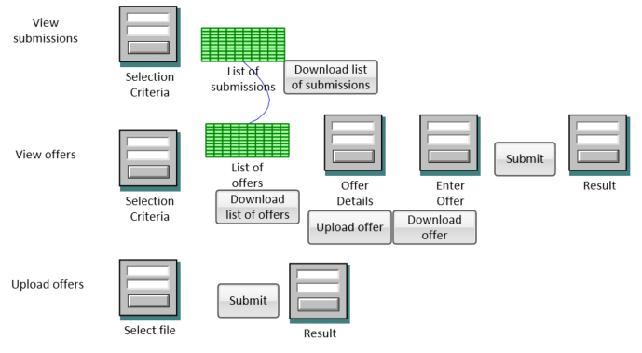
Proposed site map

Slide 16
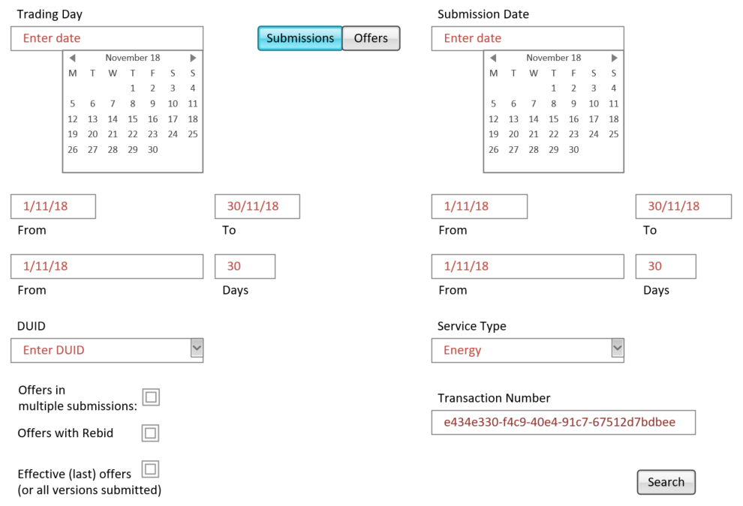
Proposed Search Criteria

Slide 17
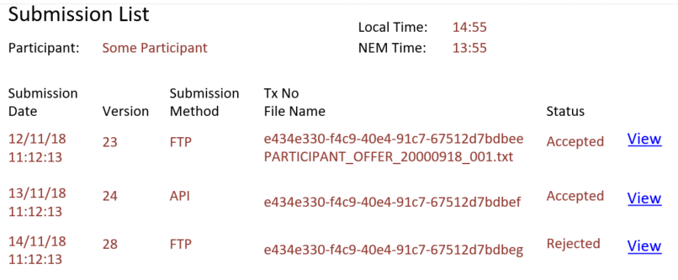
Proposed list of submissions

Slide 18
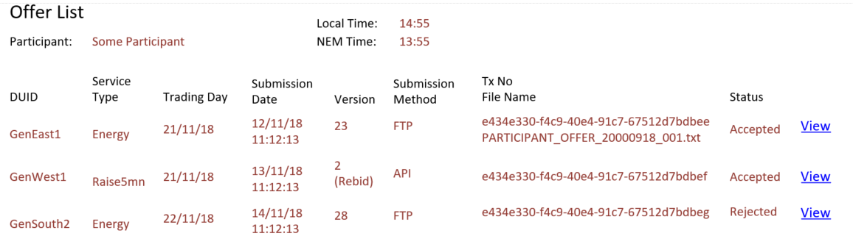
Proposed list of offers

Slide 19
Common functionality
Screen mechanics

Slide 20
List controls
Sort (by any column, by multiple columns where order can be specified). E.g:
  Sort by DUID
  Sort by DUID and Trading day (showing all trading days for each DUID) OR
  Sort by Trading day and DUID (showing all DUIDs for each trading day)
Filter (by a value in one or more columns). E.g:
  Only shows bids for a specific DUID
  Only show bids for a range of trading days (from and to)

Slide 21
List controls (2)
Export (the list details as displayed; all list details, whether displayed or not)
Print (as above)
Move/ hide/ unhide/ resize columns
Select a ‘row’ to view details (and return to this list when returning from detail screen, remembering all list settings)

Slide 22
Offer Functionality

Slide 23
Existing Offer page

Slide 24
Edit Offer - Trade intervals
Copy down (existing)
  all TI data
  selected TI data (e.g. availabilities only, 3 price bands only, etc.)
  copy down multiple rows
  formulas (e.g. set PASA to MaxAvail value)
  Cascading values: each cell defaults to the value of the cell above, unless overwritten.

Slide 25
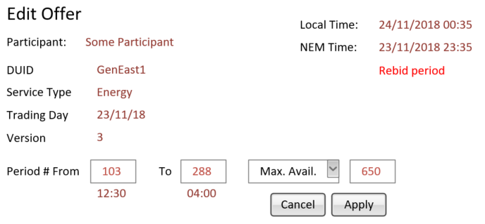
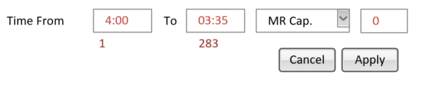
Edit Offer –
Period range and specific value

Slide 26
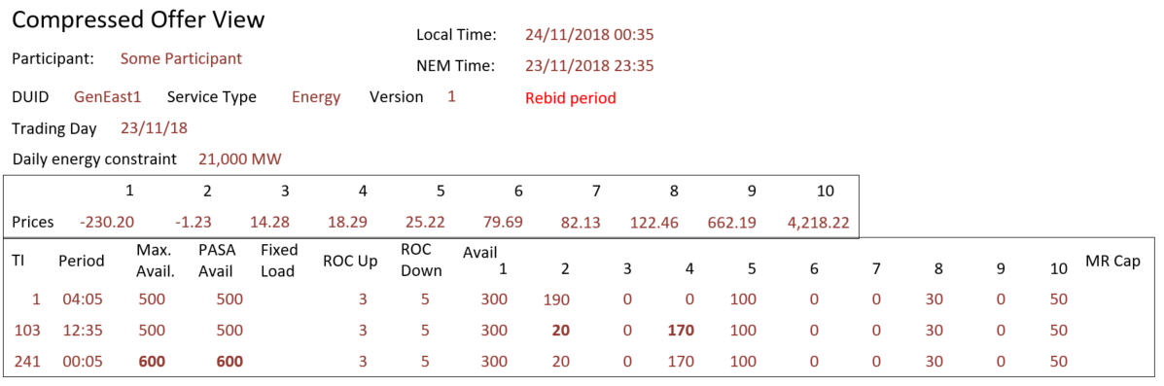
Compressed Offer View - 1

Slide 27
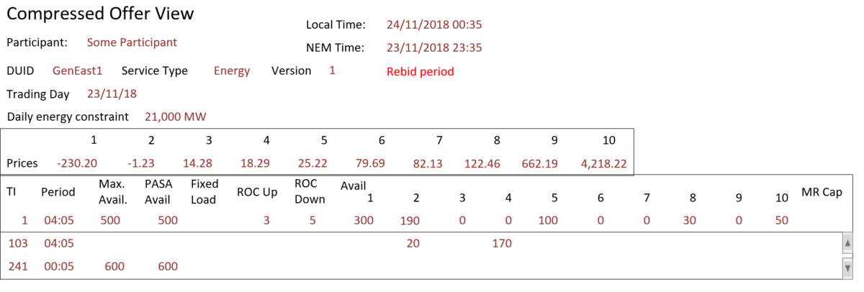
Compressed Offer View – 1a

Slide 28
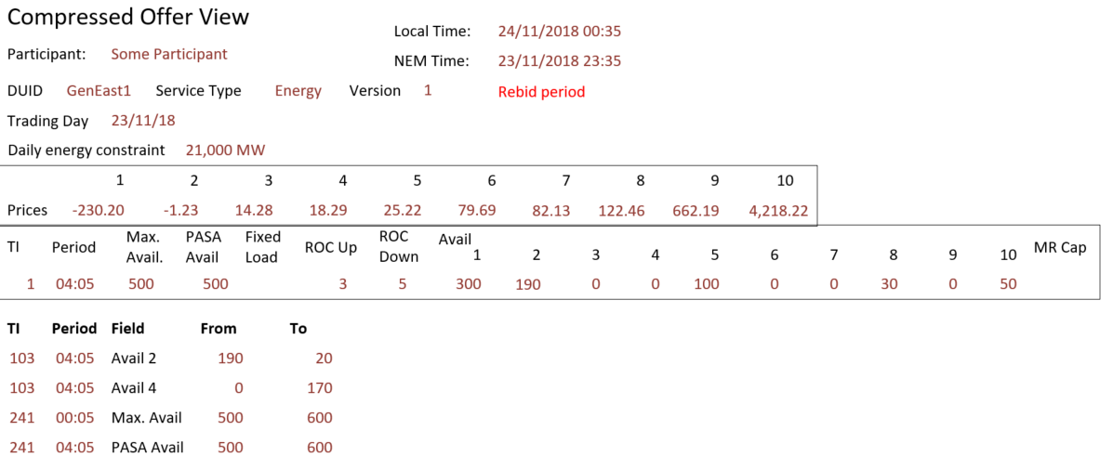
Compressed Offer View – 2

Slide 29
Save offer
Submit offer
  Receive success, with TxNo
  Receive error (see list of errors)
  Receive success with warnings (see list of warnings)
  Save response (to JSON)
Save entry without submitting (Draft offer)
  (Persistence)
  Allow retrieval of draft (offer status?)
Discard entry
  Discard (I.e. 'cancel')
  Discard (delete) saved draft

Slide 30
Complex submission
Allow user to build multiple offers into one submission.
  Might allow setting values across multiple days. E.g. Set Max Avail to 500 for the whole week.
  Might consider all days as one timeline, defaulting values from end of one day to the next.

Slide 31
Data shaping
Allow user to build business rules to help shape the data.
  E.g. Set values to x until 13:00 then increase by 5% for next 2 hours.
  Switch availability to next higher band when <some condition>.
  Set PASA to Max Avail.
  Set remaining availability to highest band (= Max. Avail - sum(bands 1-9))

Slide 32
Import / export offer
Export offer: with a currently selected offer,
  To JSON
  To CSV
Import bid, which populates the offer data,
  From JSON format (single offer)
  From CSV

Slide 33
Upload offer
Rather than import an offer, we may want to submit an offer file (i.e. submission) directly (especially if this file contains multiple offers)
Select a file (allows selection of JSON or zip) (can only select one file)
Submit
  for validation only
  for acceptance
Receive response
  Receive success, with TxNo
  Receive error (see list of errors)
  Receive success with warnings (see list of warnings)
  Save response (to JSON)

Slide 34
NFRs
Authorised: Offers must be authorised by a registered participant representative. The name of this representative and the date they authorised this offer could be recorded by the participant for reference.
Submission Traceability: (Audit) View submission details:
  Date and time the submission was received by AEMO. This is possibly different to the date and time that the participant made the submission. For example, if the participant drops a file in an FTP folder, the only time AEMO can be sure of is when the file was picked up.
  The mechanism used to submit the data. For example, AEMO is offering multiple ways of submitting bids: FTP(TXT) – Current, FTP(JSON), Web file (JSON), Web interface – current.
Offer Traceability: (Audit) View offer details:
  Date and time the offer was received by AEMO.
  The mechanism used to submit this offer.
  This may extend to each time the offer was submitted. I.e. an offer history.

Slide 35
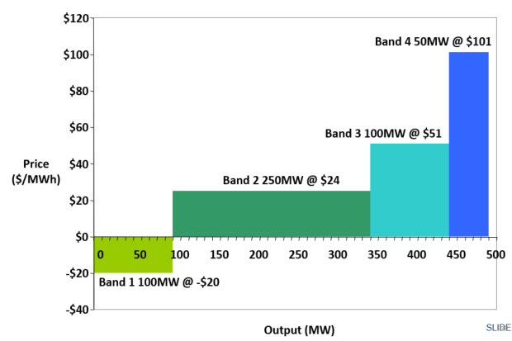
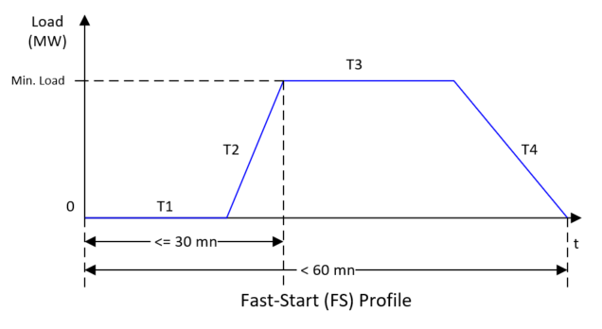
View offer - Extensions
    View bid in graph form
    Visualise FS Profile

Slide 36
View offer – Compare two offers
Propose the ability to compare two offers
  Shows what is different (similar to Unix ‘Diff’ command or to MS Word’s ‘compare documents’ function.
  Ignores timestamps which are always different
  Could compare two offers for the same trading day (different ‘versions’) or offers for different trading days or different units.
  Would need to be the same service type and same participant (unless this is for past offers).
Supply two JSON files, or select two offers in selection criteria.

Slide 37
Other Enhancements
View prices adjusted with or without Loss Factors
View incremental totals
  Total availability offered for each TI
  Running total for comparison to daily energy limit

Slide 38
Topic Objectives - Recap
Discuss the bidding web user interface proposed functions
Discuss possible improvements and the value of these
The presented bidding web user interface detail is for discussion and likely to change based on AEMO system design

Slide 39
Bidding APIs
Hamish McNeish

Slide 40
Topic Objectives
Provide an outline of AEMO’s API framework
Discuss what bidding APIs are required
Discuss possible value add bidding APIs
The presented API detail is for discussion and likely to change based on AEMO system design

Slide 41
API Framework

Slide 42
Approach
HTTP-based API services through the AEMO e-Hub are one way in which AEMO is reducing friction and complexity in accessing our systems.
The proposed approach for 5MS is to:
  Provide an accompanying API where a significant change to a web application occurs in the EMMS Markets Portal.
  For other API’s will be considered on a case-by-case basis for functions that are considered high-value to the industry.
Web bidding screens will be changed with supporting APIs provided
These APIs will likely be the same APIs for direct bidding
APIs will include the functionality available in the bidding FTP interface
APIs will offer functionality FTP will not

Slide 43
Access, Authentication and Authorisation
Access
  HTTPS communication with AEMO issued certificates
  MarketNET
  Internet
Authentication
  URM user account – provided using Basic Authentication
  Whitelisting of external IP Addresses (for internet access)
  No API Token/Key
Authorisation
  URM will be used to manage the rights for the APIs

Slide 44
Architecture
RESTful web services architecture
Conforms to the OpenAPI Specification (OAS)
URL
  https://<host>:<port>/ws/<business function>/<API version>/<resource>?<params>
  e.g.
  https://apis.prod.aemo.com.au:9319/ws/Bidding/1.0/listBids
Refer to Guide to AEMO’s e-Hub API’s on the AEMO website

Slide 45
Response Codes
Code | Condition | Description
200 | Successful request | OK
400 | Invalid API URI | The service cannot be found for the endpoint reference (EPR) <URI> "Fault": "<SystemMessageExceptionDump>"
401 | Invalid credentials | Unauthorized: Invalid Username or Password
404 | Resource not found | "Exception": "Resources for the endpoint URI not found. Endpoint URI: <Resource>"
405 | Invalid Method used (e.g. GET used instead of POST) | "Exception": "Resources for the endpoint URI not found. Endpoint URI: <Resource>"
422 | Business validation failure | Unprocessable entity
500 | e-Hub is operational but downstream systems are not available or malformed payload (JSON) | "Exception": "Application Unavailable"
503 | Exceeds Throttling Limits | Service invocation for API was rejected based on policy violation

Slide 46
Request and Response
Request:
  Headers:
    Authorization: Basic ….
    Content-Type: application/json
    Content-Encoding: gzip (TBC)
  Body:
    JSON payload
Response:
  Headers:
    Response Code: 200 OK (etc…)
    Content-Type: application/json
    Content-Encoding: gzip (TBC)
  Body:
    JSON payload

Slide 47
Response Payload
Response structure:
{
“transactionID”: “<guid>”,
“data”: { … },
“errors”: [
{
“code”: 73,
“title”: “InvalidPrice”,
“detail”: “TEST is not valid”,
“source”: null
}
}
Validation Errors:
  Response code: 422
  Errors listed in response
Warnings:
  Response code: 200 (OK) – with warnings in payload?

Slide 48
Bidding APIs
Hamish McNeish

Slide 49
Bidding Functions – Submit Bids
POST /submitBids
Submit one or more bids for:
  DUID, Trading Day, Service type
Request:
  As per JSON format
  All 288 intervals specified for each bid
  Supports multiple bids for energy/FCAS/MNSP for different units and trading days
Response:
  Validated and accepted by AEMO (possibly with warnings) – 200 OK
    “data”: { “offerDateTime”: “2018-11-18T15:44:00” }
  Validation error – 422
    “data”: { “offerDateTime”: “2018-11-18T15:44:00” }
    “errors”: [ … ]

Slide 50
Bidding Functions
Driven by web bidding decisions and design outcomes
API resource | Purpose | Parameters
POST /submitBids | Submit JSON bid format to AEMO | None
GET /listBids | List effective bids for a trading day range. OfferDateTime, TradingDay, DUID, Service, EntryType (Rebid/Daily), VersionNumber Provides the data in BIDDAYOFFER | From To <optional> DUID <optional> Service <optional>
GET /viewBid | View bid: Return effective (or specific bid version) in JSON bid format Provides the data for a bid in BIDDAYOFFER/BIDPEROFFER | Trading Day DUID Service OfferDateTime <optional>
GET /listSubmissions | List submissions based on a calendar date range. PID, OfferDateTime, Status, Authorised By, Authorised Date, Transaction ID Provides the data for a bid in BIDOFFERFILETRK | From To <optional>
GET /viewSubmission | View submission: Return JSON payload as submitted Currently only available via FTP | Transaction ID
GET /viewResponse | View submission response: Return JSON response Currently only available via FTP | Transaction ID

Slide 51
Bidding Functions
Other possible options
  There was support at the last SWG for being able to vary an existing bid.
Others?
API resource | Purpose | Parameters
POST /varyBid | Vary an existing bid: JSON format to vary specific intervals Fails if no bid exists for that day | None

Slide 52
Topic Objectives - Recap
Provide an outline of AEMO’s API framework
Discuss what APIs are required
Discuss possible value add APIs
The presented API detail is for discussion and likely to change based on AEMO system design

Slide 53
General questions and next steps
Michael Sanders & Hamish McNeish

