Slide 1
Marginal Loss Factors for FY20/21
Industry briefing for Final Report

Slide 2
Agenda
Context
Summary of results
Impact of COVID-19
Region summary
Approach for FY21/22
Methodology review
Appendix – regional summary for load/generation

Slide 3
Context
AEMO is required to publish final MLFs by 1 April each year
MLFs represent the locational price signal for the following financial year, 2020-21
Are based on a forward-looking methodology, that reflects forecast changes in demand, generation, and network configuration
For FY20/21, AEMO published:
An indicative report in November 2019
A draft report on 4 March
The final report on 1 April

Slide 4
Summary of results
Compared to recent years, changes in MLFs are not as dramatic:
Emerging network limits in south-west NSW and northern Qld have offset the increased output from renewables, reducing the trend of declining MLFs for generators in these areas
Changes in MLFs largely driven by the changing generation mix, and resulting interconnector flows
AEMO engaged a consultant to review the MLF process:
Confirmed the FLLF was being appropriately applied
Verification study identified a high degree of alignment of MLF values

Slide 5
Impact of COVID-19
COVID-19 is expected to have a significant short-term impact to consumption patterns and total energy demand, but longer term impact (including over FY20-21) remains uncertain
Demand forecasts used for MLFs were taken in February, prior to impact of COVID-19
Impact to MLFs is uncertain, and at the moment AEMO has limited scope to revise MLFs

Slide 6
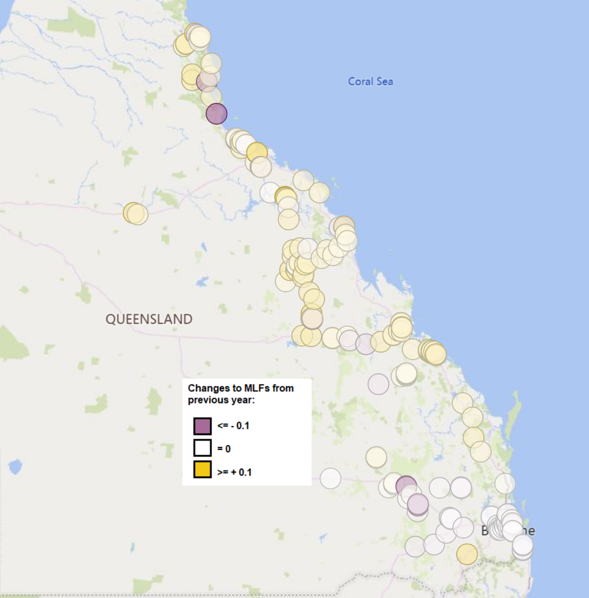
Qld
A decrease in MLFs at connection points in southern Queensland, and an increase in MLFs at connection points in northern and central Queensland.

Slide 7
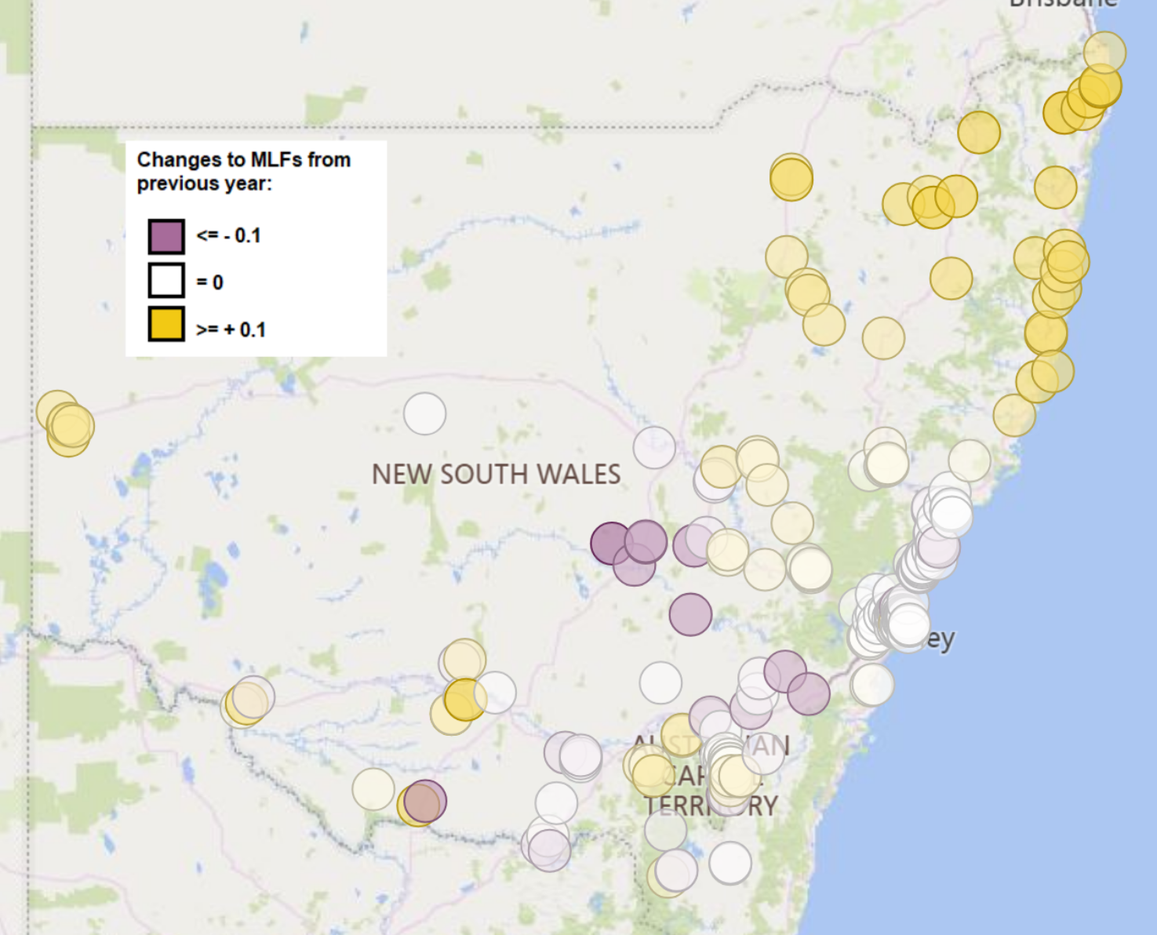
NSW
An increase in MLFs at connection points in northern and south-west New South Wales, and a decrease for remaining areas of New South Wales. Generation MLFs in south-west New South Wales have increased as generation output in this area is reduced by network limitations.

Slide 8
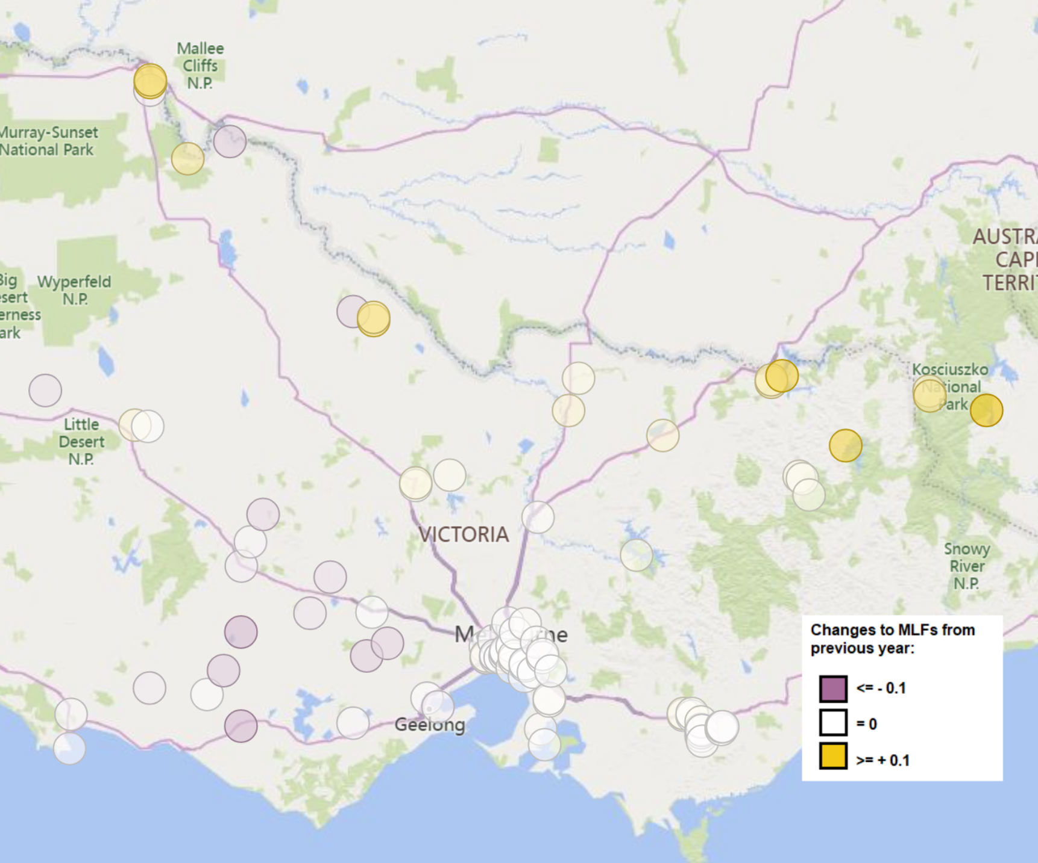
Vic
An increase in MLFs at connection points in northern Victoria, and a decrease in MLFs at connection points for western Victoria. Generation MLFs in north-west Victoria have continued to decline, while load MLFs in this area have increased.

Slide 9
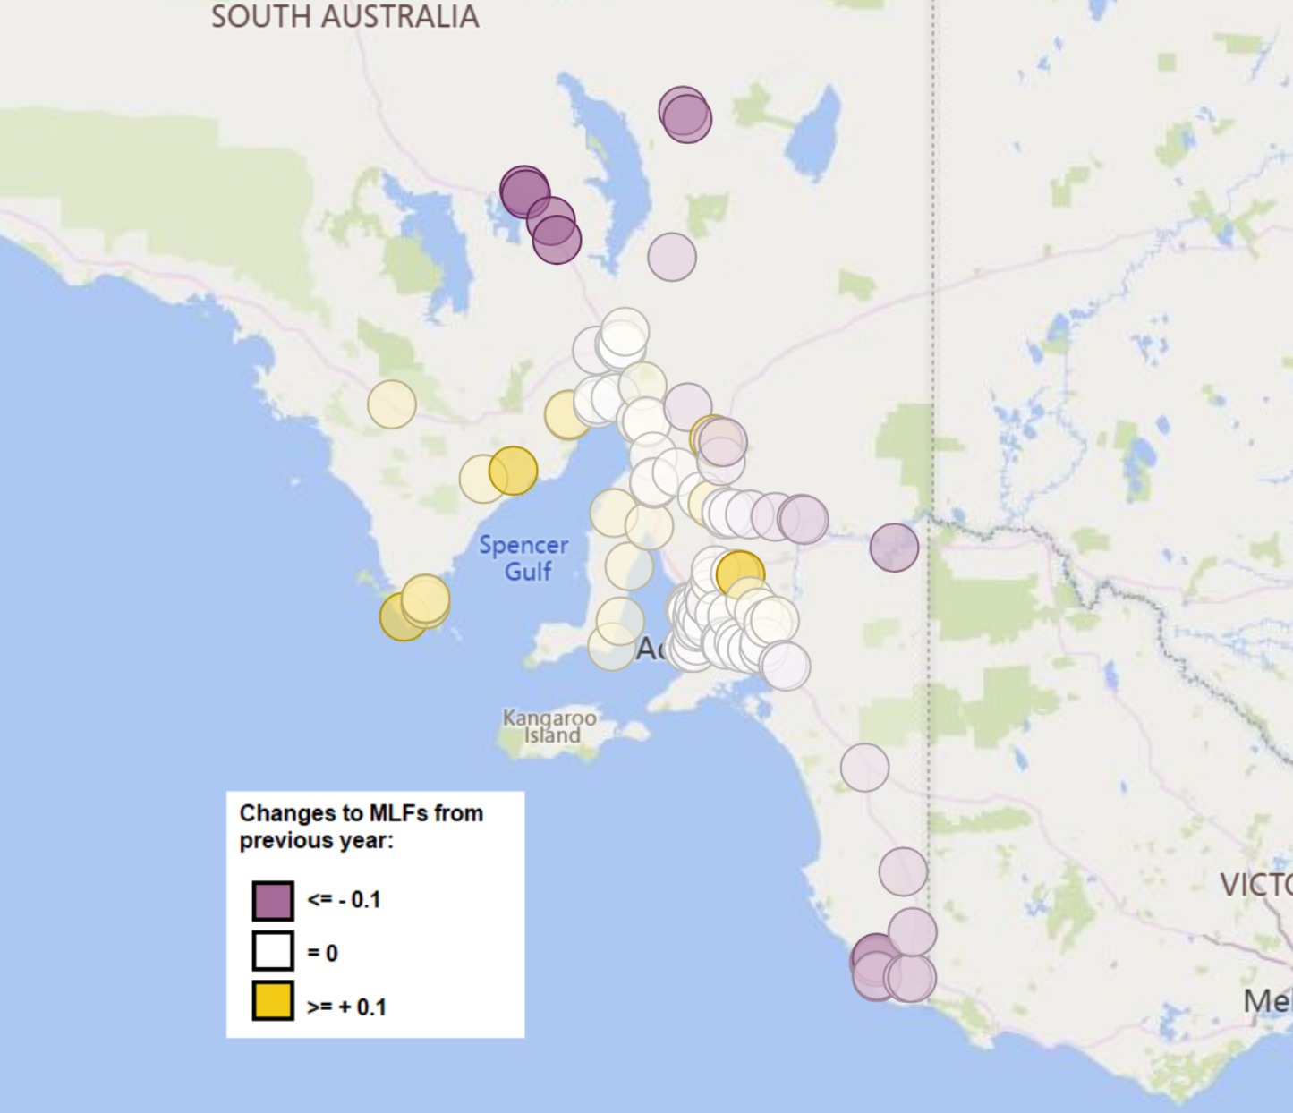
SA
A decrease in MLFs at connection points in the south-east and Riverland area in South Australia.

Slide 10
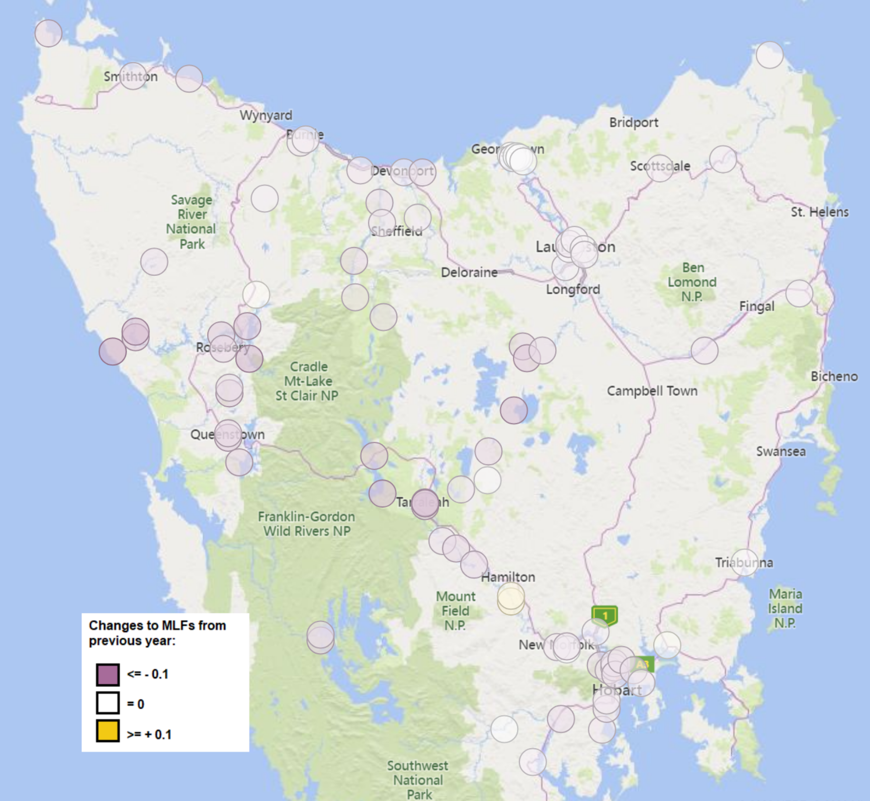
Tas
A general decrease in MLFs at connection points in Tasmania.

Slide 11
Approach for FY21/22
AEMO is committed to improving transparency of the MLF process, and for the 2021-22 financial year are proposing to publish the following:
August 2020 – early indicative report
December 2020 – indicative report
1 March 2021 – draft report (as per current methodology)
1 April 2021 – final report (as per Rules)

Slide 12
Methodology review
AEMO will be reviewing the current Forward Looking Loss Factor (FLLF) methodology, in order to:
Incorporate changes to the Rules from the recent AEMC final determination
Re-align the methodology with changes in operational practise, particularly with respect to new generation
Address any issues with the methodology, including in light of the changing generation mix
Aiming to have pre-consultation discussions in April and May, but refining our approach in light of social distancing

Slide 13
Appendix – Regional summary for load/generation

Slide 14
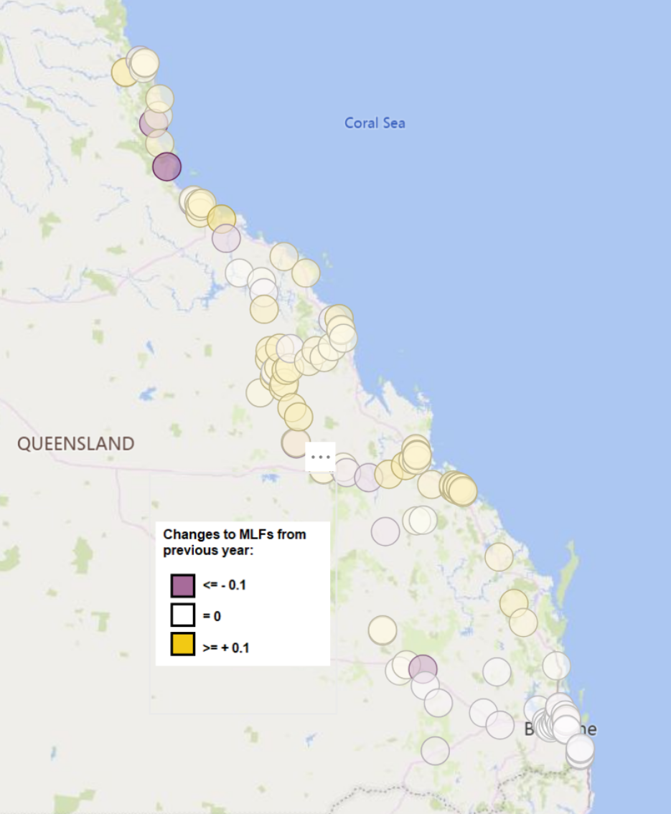
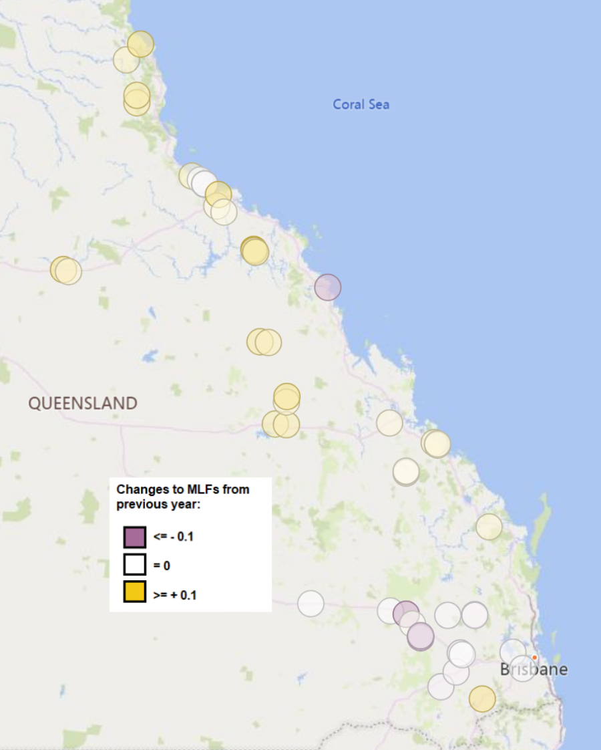
Qld
Loads
Generation

Slide 15
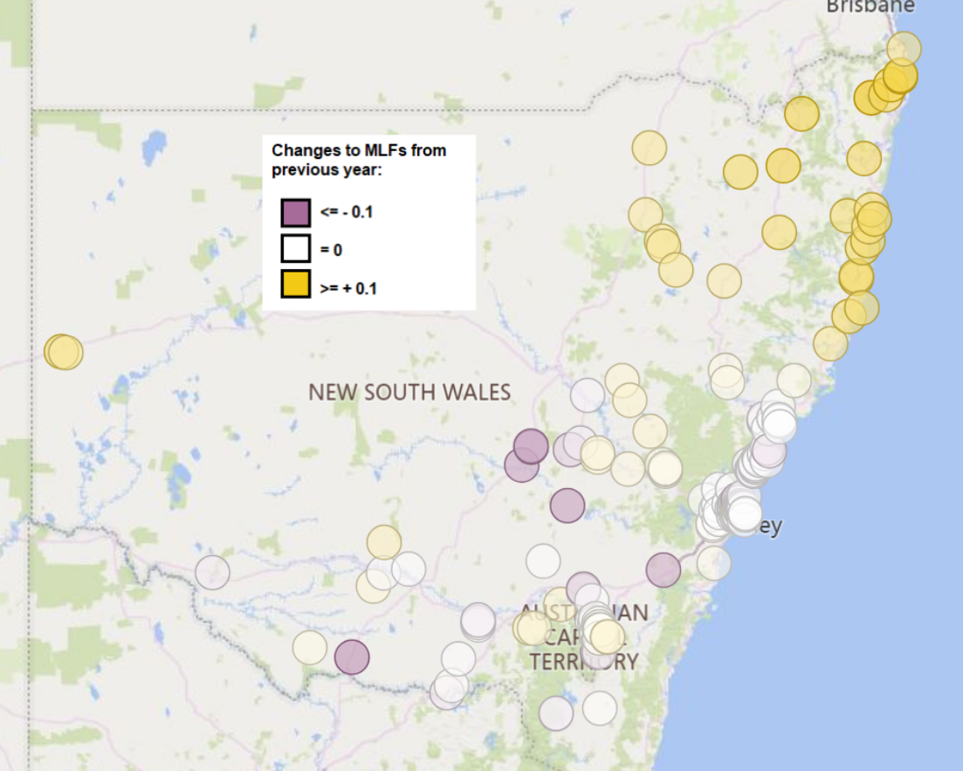
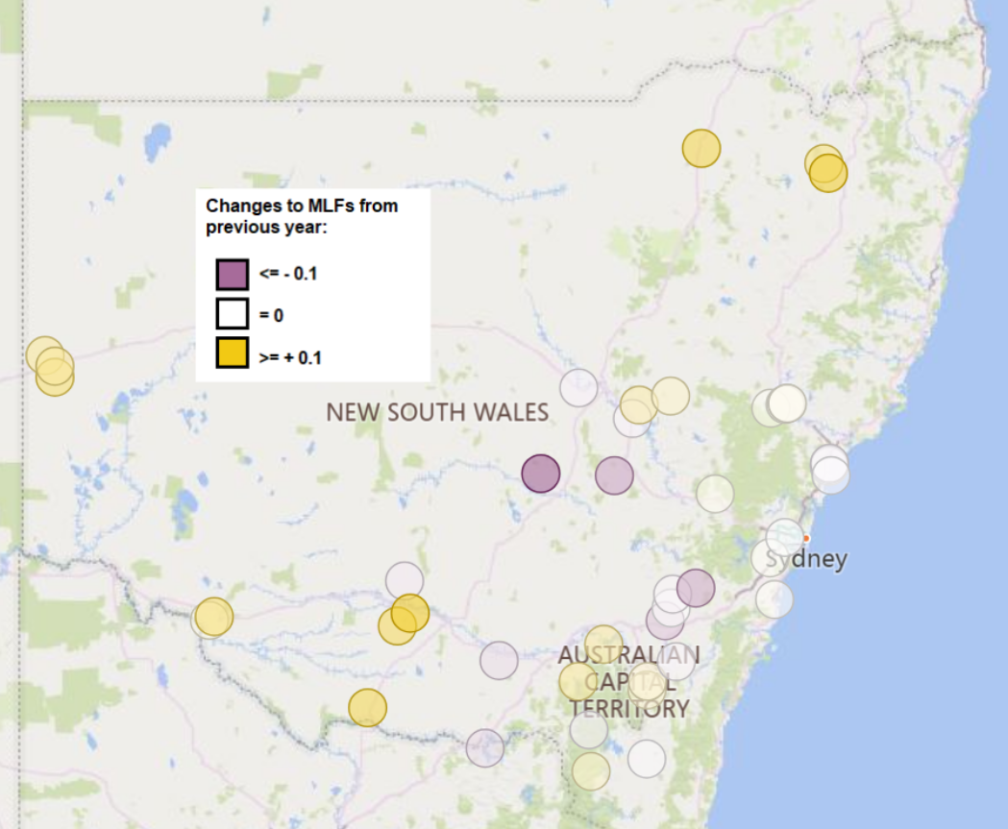
NSW
Loads
Generation

Slide 16
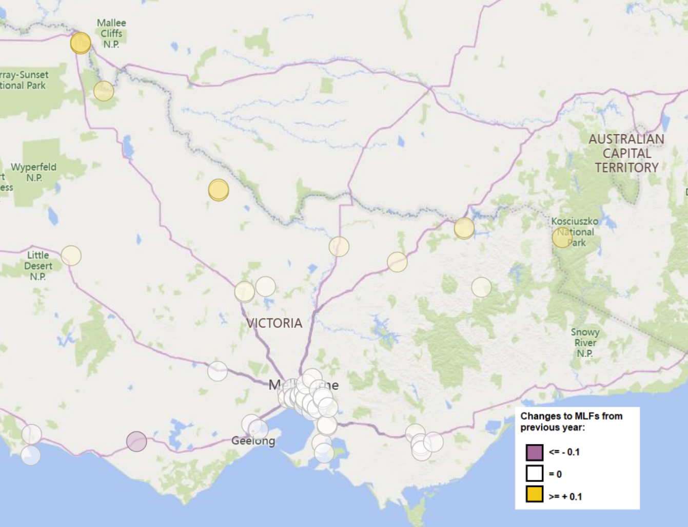
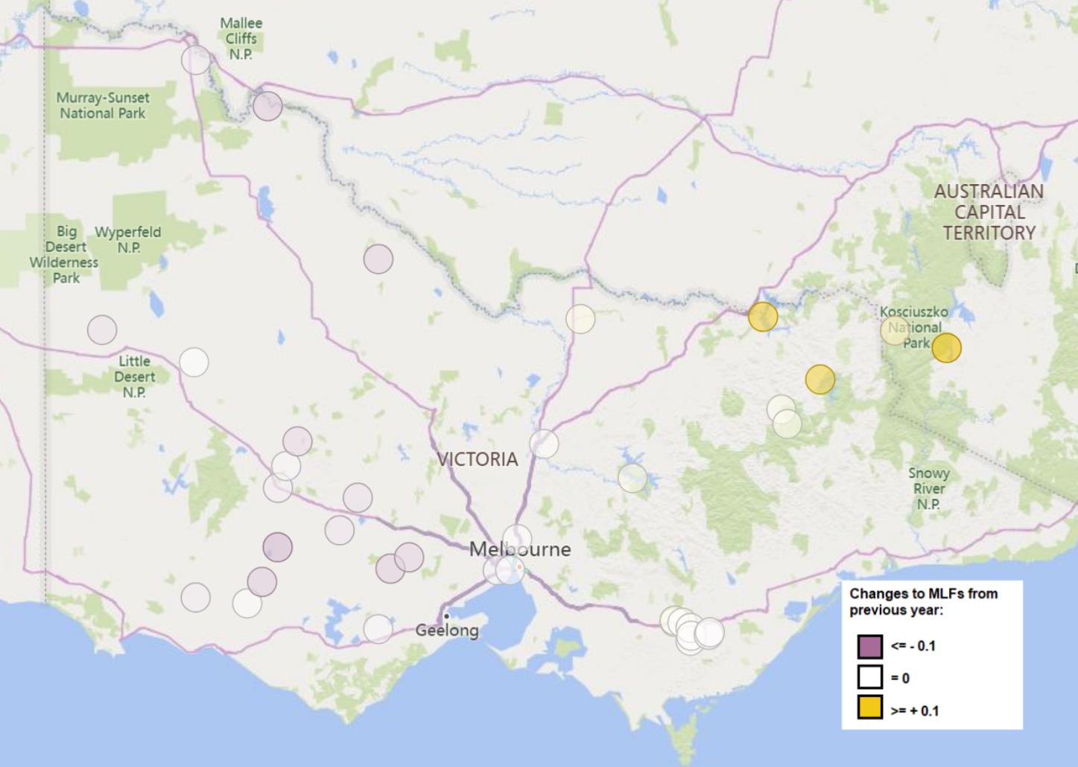
Vic
Loads
Generation

Slide 17
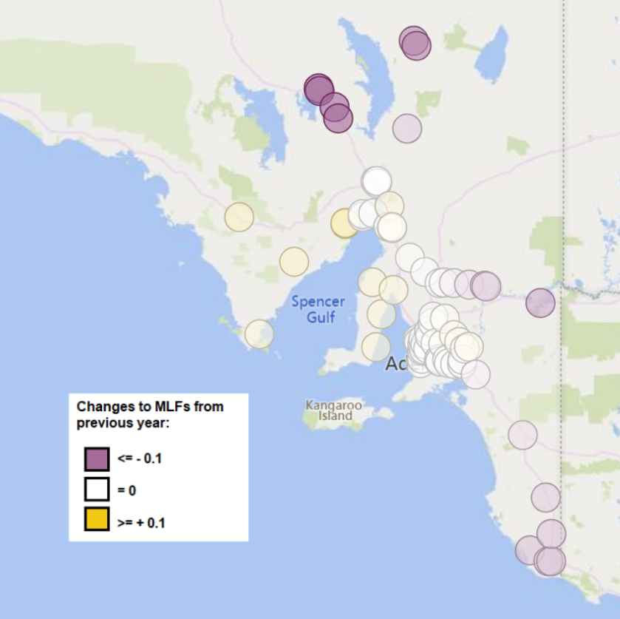
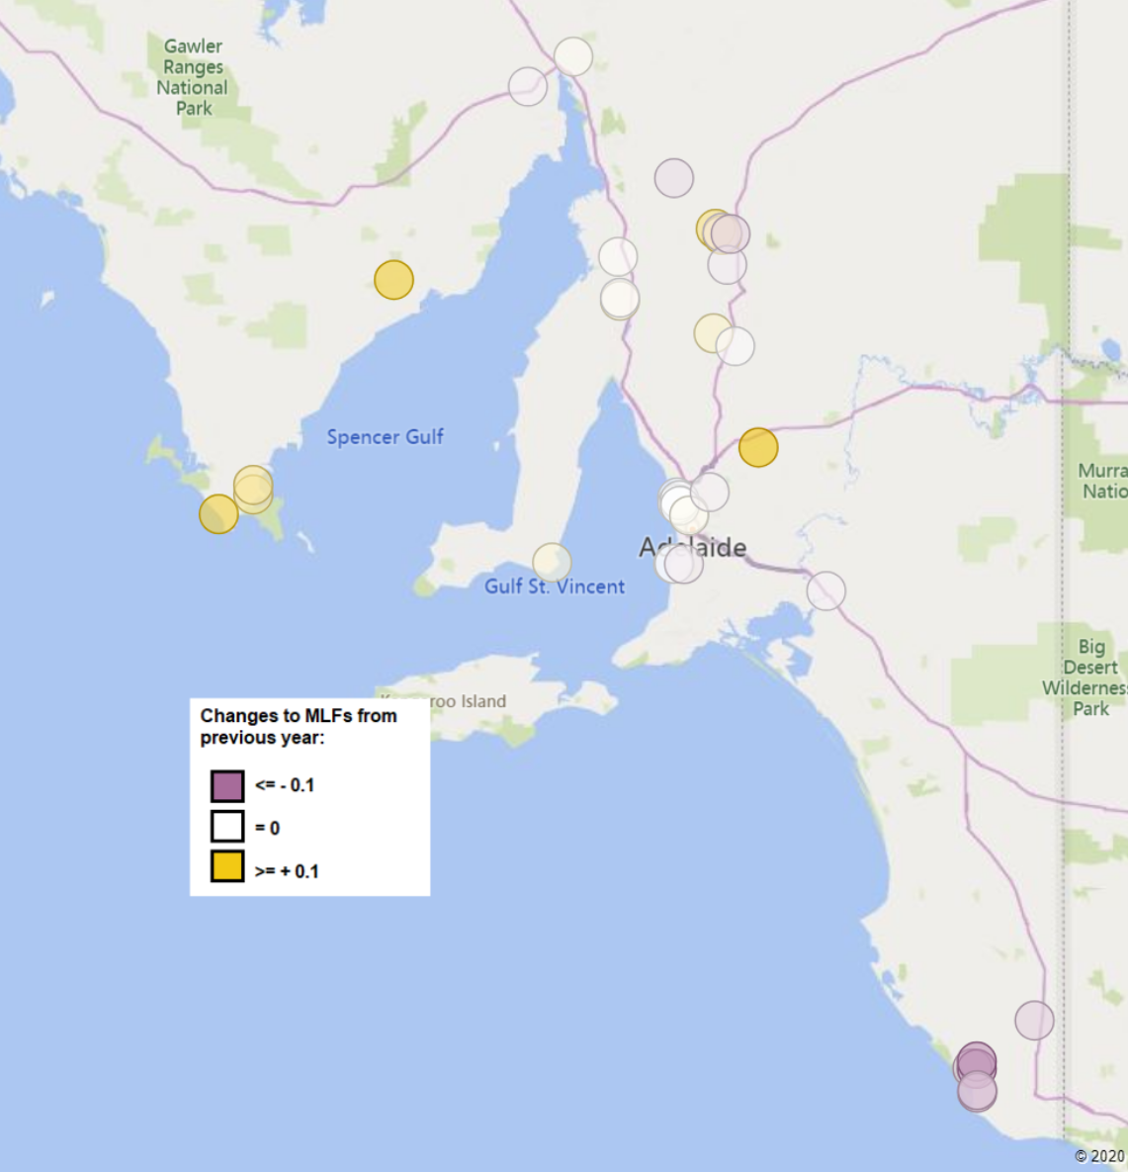
SA
Loads
Generation

Slide 18
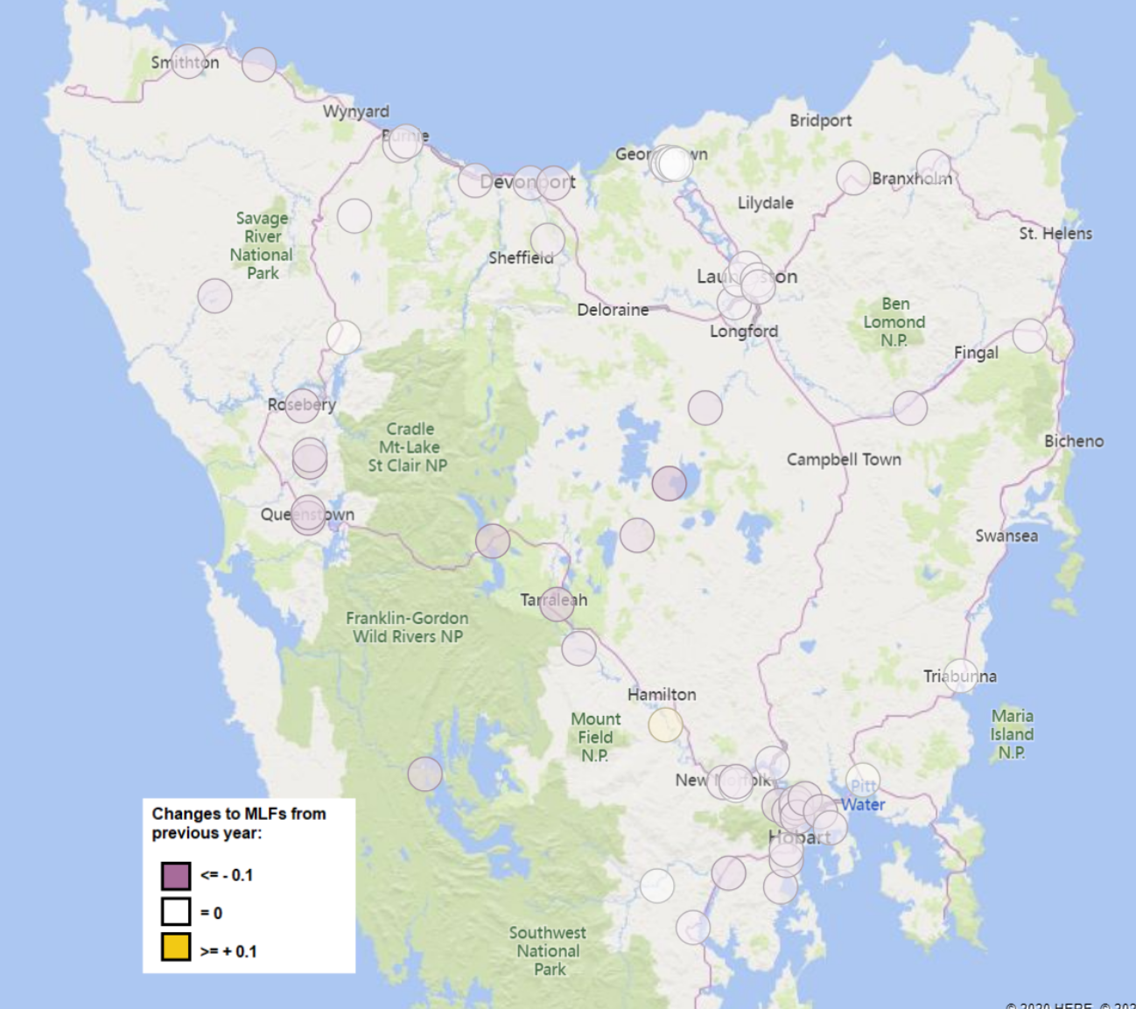
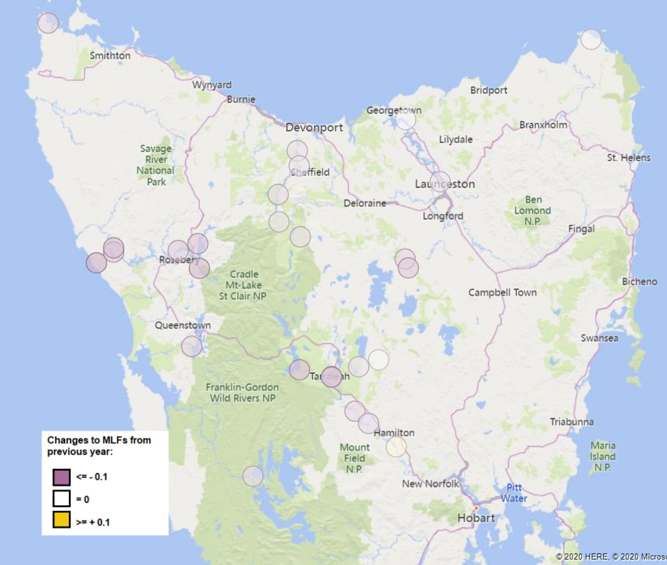
Tas
Loads
Generation

